Slide 1


“Vitalizing Local Economy X ICT”
in Fukuoka Style
November 2015
Mayor of Fukuoka City Soichiro Takashima

Slide 2

Viewpoint of Vitalization of Local Economy
Conventional
Local Vitalization
Balanced Growth
of the Whole Country
Future
“Local Vitalization”
Government Assistance & Support to Motivated Cities
Notes:
・ With “Local Vitalization” as a turning point, the government seemed to shift the focus from the previous “Balanced Growth of the Whole Country” to supporting “motivated cities with eagerness to take on innovative changes”.
・ In the circumstances of declining population, we understand “Local Vitalization” from now on is autonomous administration by these active cities.

Slide 3
Keywords
「IoT」
「BigData」
「ICT」
Notes:
・ In order to survive in the era of Local Vitalization, and from the viewpoint of utilization of ICT, Fukuoka City would like to enumerate 3 keywords of “Big Data”, “IoT” and “ICT”.

Slide 4
■ Fukuoka City Wi-Fi
The biggest annoyance foreign tourists experienced in Japan was “Poor Free Public Mobile Communication Environment” which 23.9 % of them cited.
Source : “Questionnaire Survey for Foreign Tourists in Japan in 2011” by Japan Tourism Agency (Prepared by Japan Tourism Marketing Co.)
Notes:
・ Although this is the data obtained a few years ago, the result of the questionnaire survey conducted to visiting foreign tourists to Japan indicated their dissatisfaction with the poor public mobile communication environment as the biggest annoyance.
・ With this backdrop, Fukuoka City Wi-Fi is really appreciated as a very popular service for visiting foreign tourists to Japan.

Slide 5

■ Fukuoka City Wi-Fi
Fukkoudai Mae St.
Total 83 Places in Whole City
（No. of Access Points 376）
※ As of Oct., 2015
Kyusandai Mae St.
Kashii St.
Tourist Info. Center/
City Hall 1F/
Fureai Square/
Rainbow Plaza (IMS 8F)
Chihaya St.
“Hakata Machiya”
Furusato House
Fukugin
HQ. Plaza
Fukuoka Parco
Yoshizuka St.
Central Pier
Cruise Center
SRP Center Bldg.
Tenjin Core
Resora South Terrace
THE BEACH
Asumin
Hakata Port
International Terminal
Solaria Stage
Fukuoka Student
Exchange Center
Fukuoka Tower
Fukuoka Airport
(Domestic)
City Museum
City Museum
of Art
Tourist Info. Center
Toyo Hotel
City General Library
Hakata St. Underground
Complex, Hakata Ichiban
Kyudai Gakkentoshi St.
Fukufuku Plaza
Hakata St.
Fukuoka Airport
(International)
Daimaru Fukuoka Tenjin Branch
Canal City Opa
City Facilities
Iwataya Head-Office Square
Hakata Bus Terminal
Private Facilities, Airport
Resora Tenjin
TSUTAYA BOOK STORE TENJIN
Sutton Hotel
Hakata City
Vending Machines
Resora South Terrace
Minami Fukuoka St.
Fukuoka City Subway
Nishitetsu Tenjin St.
Amikasu
Hotel New Otani
Hakata
Agora Fukuoka
Hilltop Hotel & Spa
Nishitetsu Tenjin
Bus Center
※ Omitted Subway Station Names
※ As of Oct. 1, 2015
Notes:
・ Let me elaborate Fukuoka City Wi-Fi a little more which makes use of Big Data.
・ Fukuoka City has introduced the free public mobile communication service “FUKUOKA CITY Wi-Fi” in April, 2012.
・ As of October, 2015, access points has reached as many as 376 points in Fukuoka City.

Slide 6
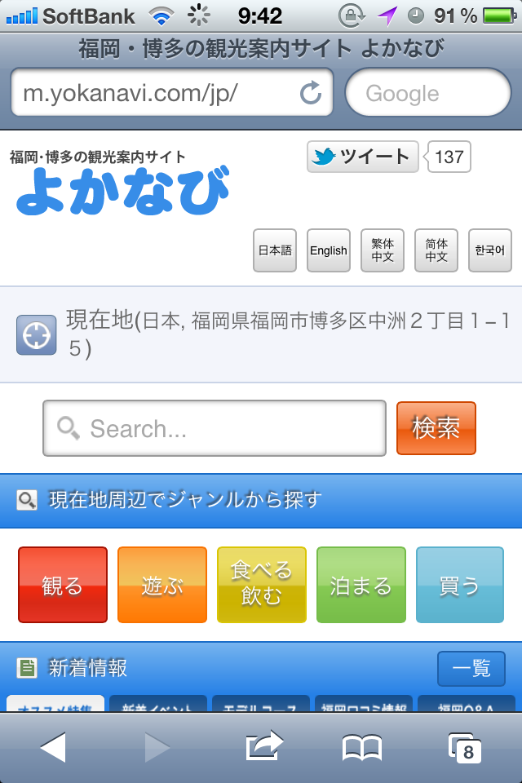
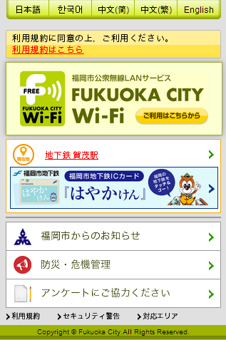
■ Information Provision by Fukuoka City Wi-Fi
Upon Internet Connection, Get Access to the City’s Sightseeing Info. Site “Yokanavi”.
It Detects the User’s Current Location by a Positioning System, and Provides Relevant Info. regarding the Location including Sightseeing & Events.
It delivers tourist information of the current place and nearby areas(possible to provide different info. from one place to another.)
It provides the city’s administrative notices as well as various information regarding tourism and events.
Notes:
・ In addition, we provide sightseeing information and other up-to-date news of Fukuoka City area making use of Fukuoka City Wi-Fi.

Slide 7
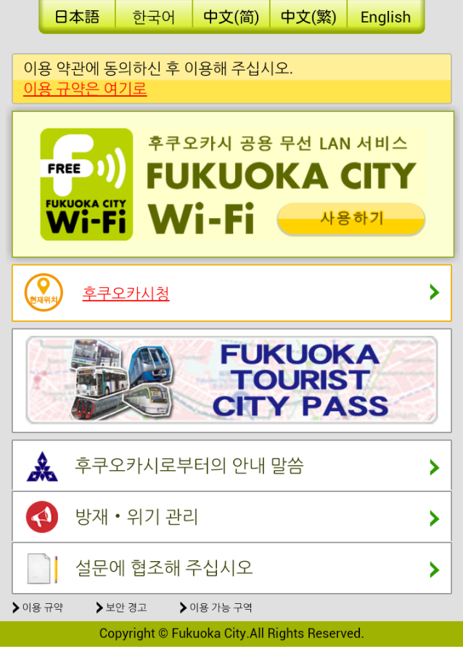
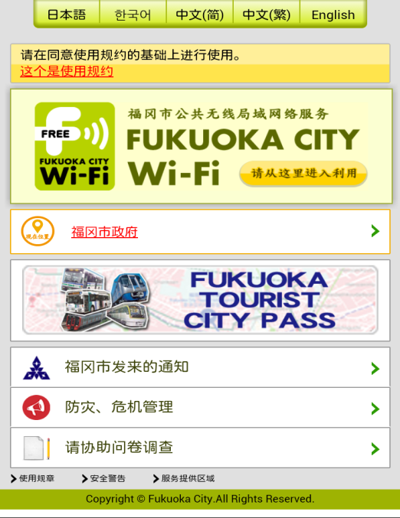

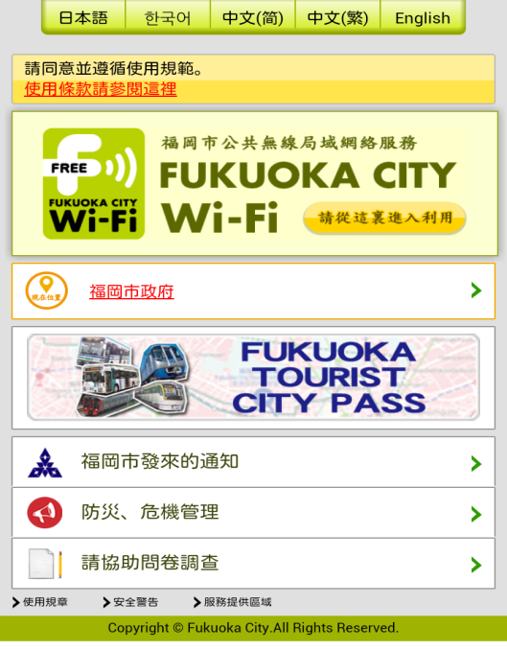
■ Information Provision by Fukuoka City Wi-Fi
It Deals with Japanese, Korean, Chinese(Simplified & Traditional Characters) and English.
It Provides Info. regarding City’s Administration, Areas, Disaster Prevention, etc. in the Language Selected by the User.
Chinese (Simplified/Traditional)
Korean
English
Notes:
・ Information is provided in 5 languages.

Slide 8
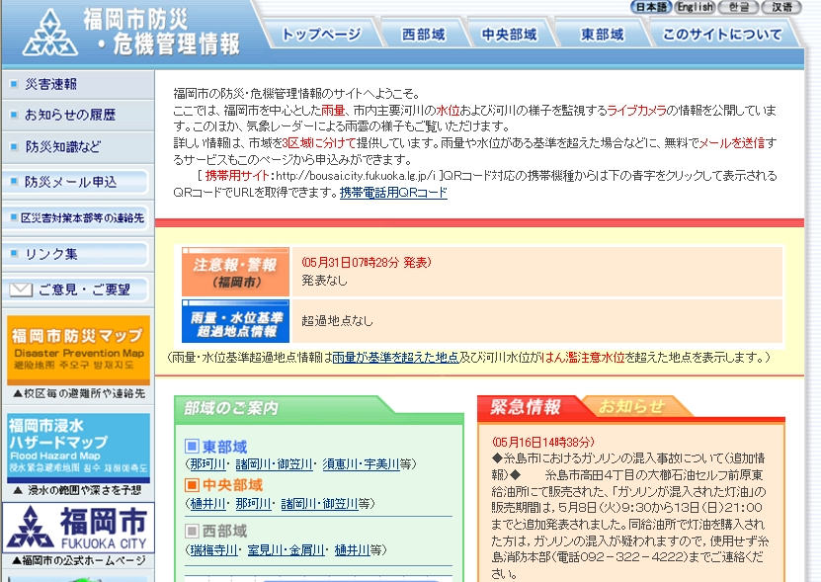
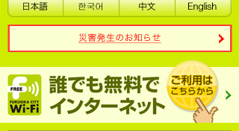
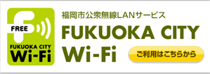
■ Information Provision by Fukuoka City Wi-Fi
Emergency Info. such as Disaster Occurrence is Sent to Users’ Portal Screens.
Even Foreign Visitors Who are Vulnerable to Disaster are Kept Informed of Disaster Information.
Emergency Notice
(Only at the Time of Disaster & Emergency)
Fukuoka City Disaster Prevention & Crisis Management Information Page
Tap
At the time of disaster of extreme severity, the registration and certification procedures are waived.
Notes:
・ Furthermore, in case of emergency such as disaster occurrence, etc., we send the information on the portal screens of users, and we can lead them to the Disaster Management Information Page.

Slide 9
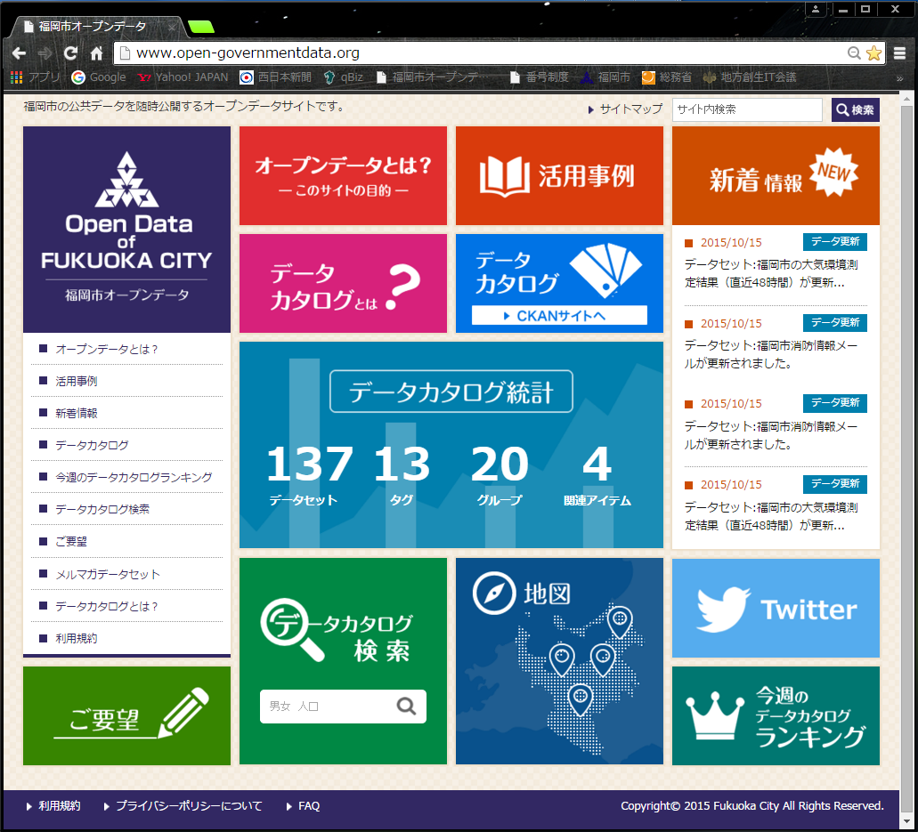
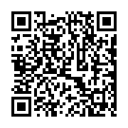
■ Fukuoka City Open Data Site
Started Operation of Fukuoka City Open Data Site in October, 2014
・Processed Administrative and
Statistical Info. into Open Data.
・Invited Ideas of Open Data
Utilization through Ideathon, etc.
・Organized a Start-Up Cafe for
Discussion.
【福岡市】
Creation of New Value
(Starting Up Businesses, Vitalization of Businesses, etc.)
http://www.open-governmentdata.org/
Notes:
・ Let me explain Fukuoka City’s approach to Big Data.
・ Fukuoka City has inaugurated the exclusive site of Open Data in October, 2014 which was fairy earlier than other cities.
・ With this site, we expect users to freely use administrative data owned by Fukuoka City, and to freely think about the ways of data utilization, and to use them for higher quality of life or for their businesses.

Slide 10
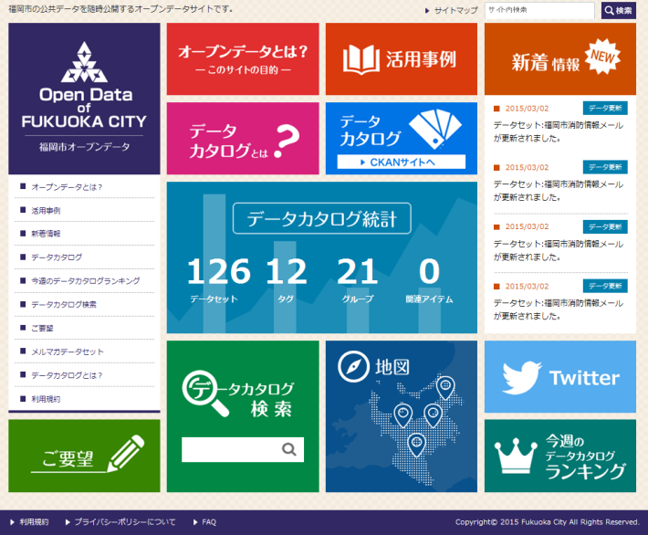
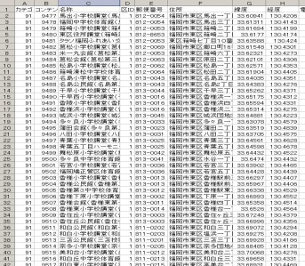
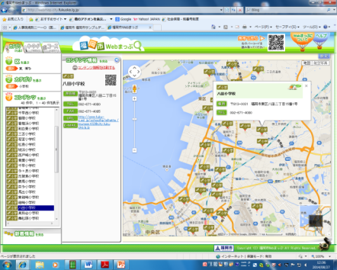
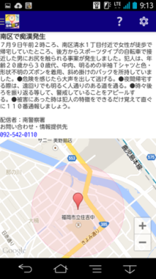
■ Fukuoka City Open Data Site
Open Data Site
(Administrative Information)
Private Businesses, etc.
Making Use of Open
Data for Providing a
Variety of Services.
Notes:
・ Open Data is quite useful for vitalization of users’ businesses, and associated improvement of citizens’ life.
・ While data themselves are merely rows of numbers, it is great when they are visualized by applications and websites to create new value and help citizens’ life.

Slide 11
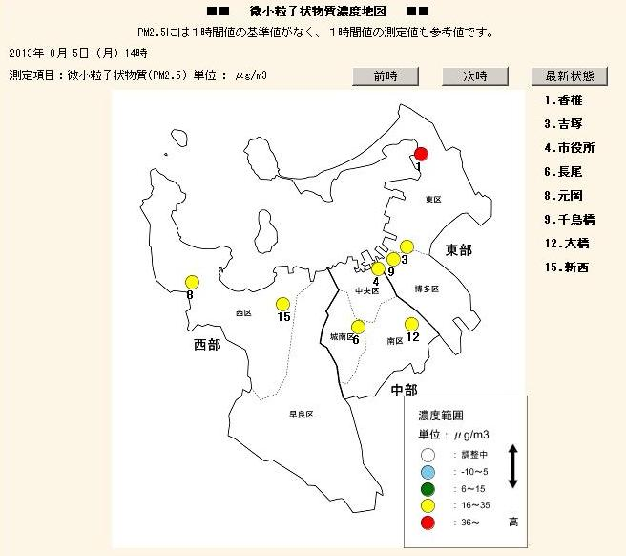
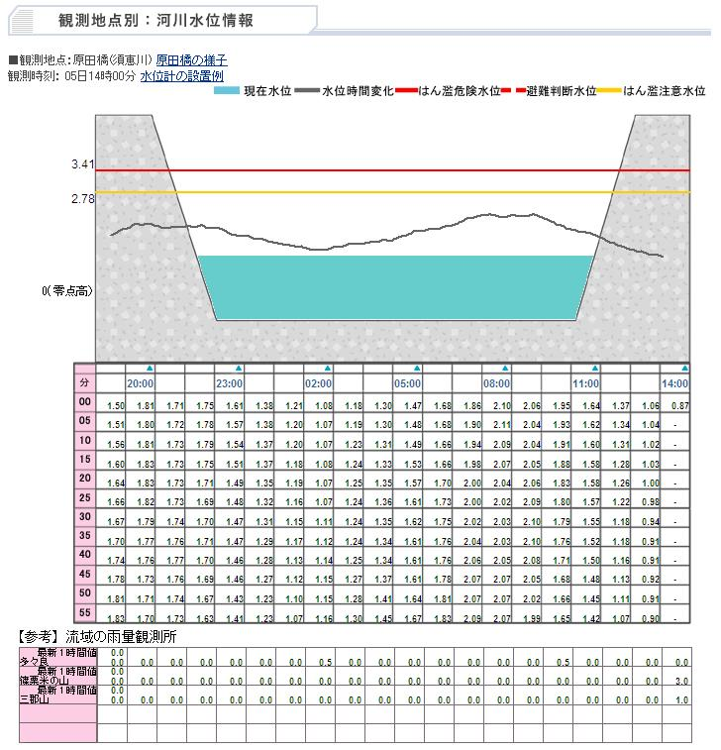
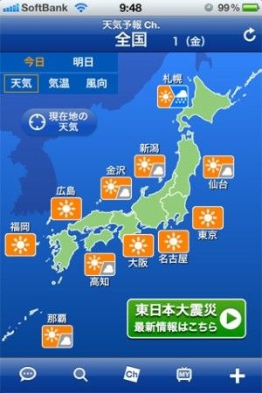
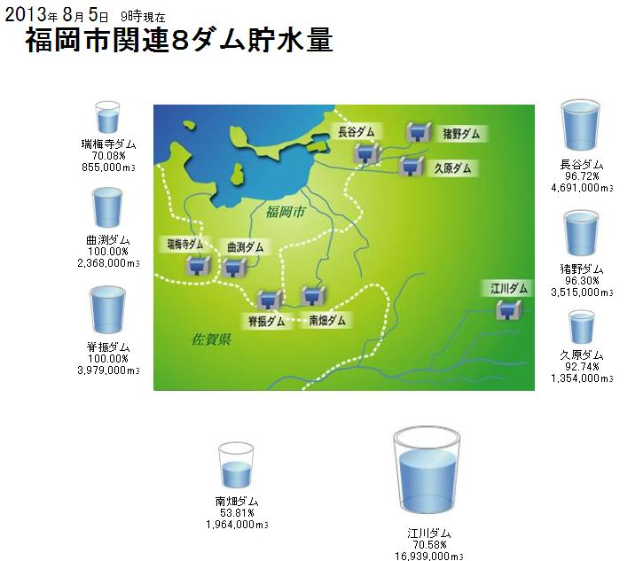
■ Open Data Utilization (Image)
○ PM2.5 Density Map
(Environment Bureau)
○ River Water Level Information
(Citizens Bureau)
○ Dam Water Storage Info.
(Waterworks Bureau)
For Example, Information Transmission from Private Weather Info. Sites utilizing Info. such as PM 2.5, River Water Level, Dam Water Storage provided by Local Authorities
Notes:
・ This shows examples of combination of information of public and private sectors. For example, the environment data such as PM 2.5, and river water level information by every 5 minutes provided by Fukuoka City can be combined with data of private sector weather information firms to create value-added data useful for businesses and civil life.

Slide 12
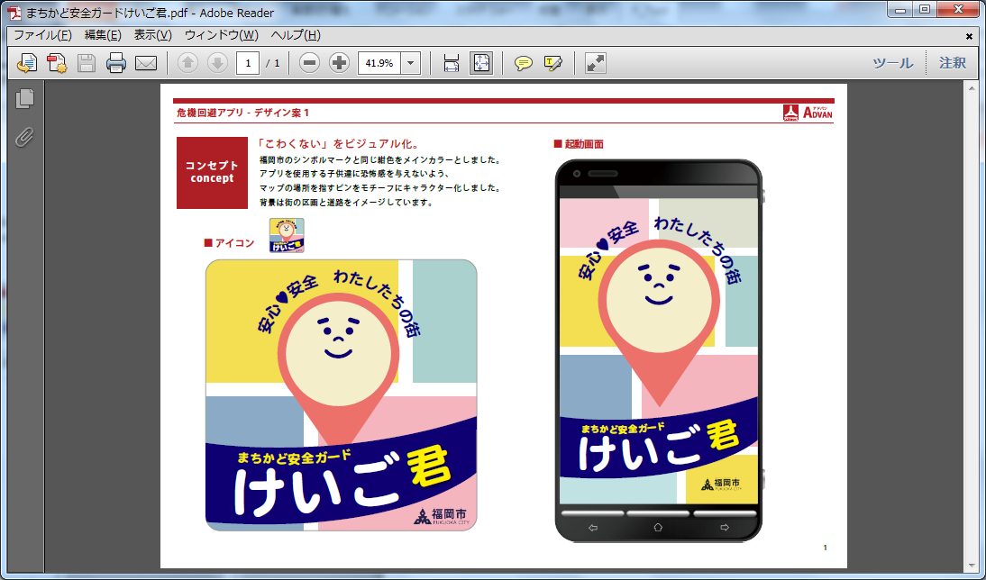
■ Street Safety Guard App. “Keigokun”
Notes:
・ This is the third example of information provision to the citizens making use of ICT.
・ The street safety guard application named “Keigokun” is to send the crime occurrence information to smart phones of the citizens.
The information is originally from the mail magazine published by Fukuoka Prefectural Police, and information of date, time and location is processed into open data for provision to the citizens.

Slide 13


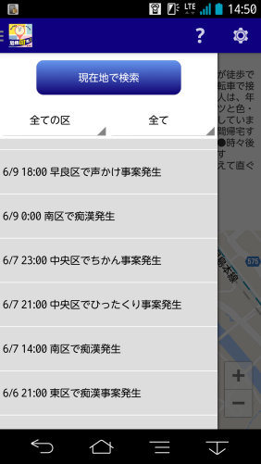

■ Street Safety Guard App. “Keigokun”
Provision of “Fukkei Security Mail” Produced by Fukuoka Prefectural Police
① in Real Time, ② to Display on the Screen, ③ Searchable for the Past Information
“It says an incident happened at XX. It might be better to make a detour.”
“It seems incidents happened many times around here. Let’s be careful on our patrol in the community.
Notes:
・ Up until recently, due to the nature of mail magazine, problems persisted in terms of abolishment of the information soon after they were read, and obscurity of the place of crime in spite of description in letters.
・ Thanks to this application, it became possible to get information : ① in real time (with only one click), ② in a manner of being displayed on the map, and ③ with the storage of the past information in a searchable manner.
・ This application has been operational since July 2014 in Android version. In response to the request of iPhone users, the application with iPhone version was introduced in October 2015.

Slide 14
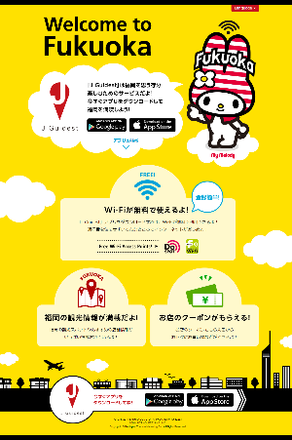
■ Fukuoka City Wi-Fi
Introduced as a part of local vitalization trial through enhanced services for foreign tourists.
For the purpose of publicity and invitation of sightseers as well as seizure of new business opportunities.
In collaboration with groups of JTB and NTT, and for the purpose of increased satisfaction of visiting foreign tourists and vitalization of local society and economy,
a verification test of information provision application making use of Wi-Fi was conducted.
Notes:
・ Another noteworthy measure we took was a verification test of a tourist information provision application for visiting foreign tourists which makes use of Fukuoka City Wi-Fi conducted in the period from October 2014 to April 2015. This was made in collaboration between Fukuoka City and groups of NTT and JTB.
・ In the test period, while tourist information was provided to visiting foreign tourists in English, Chinese (in traditional and simplified characters), and Korean, the information of what tourist spots they visited, and what routes they passed, etc. which compose a part of big data was made available.

Slide 15
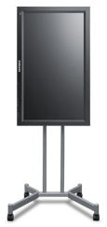
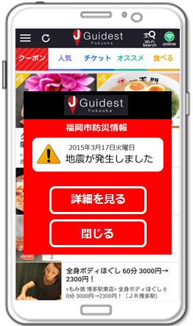
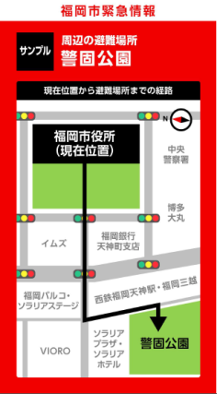
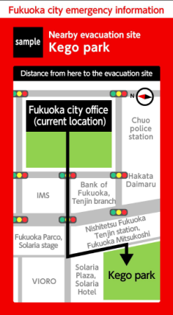
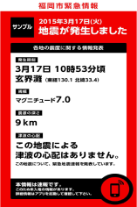
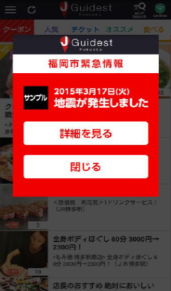
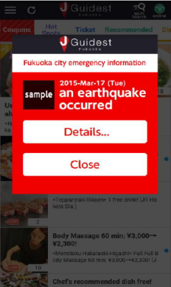
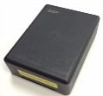
■ Emergency Information Provision through Wi-Fi & Beacon
Demonstration for “City’s Disaster Prevention Day” (March 20, 2015)
Emergency information provision in association with Wi-Fi, digital signage, beacon and application.
As Contents are Available in Plural Languages, It is Possible to Provide Emergency Information to Foreign Visitors.
Projected the Emergency Information Contents on Digital Signage.
Information Details are Conveyed through Beacon, and Displayed on the Screen of User’s Terminal in the Language according to that of the Terminal.
Notes:
・ Now, let me talk about “IoT”.
・ In Fukuoka City, we conducted the verification test of emergency information transmission in association with Fukuoka City Wi-Fi, Beacon, and Application, etc. in March 2015.
・ This system not only provides the location information of Wi-Fi access points, but if it is used with Beacon, it sends emergency information to the portal screen, and then leads the users to the Disaster Management Information Page.

Slide 16


■ National Strategic Special Zones
Regulatory Reform of Wireless Radio Act
IoT World Market Forecast
1,700 billion $
655.8 billion $
2014
2020
Source：IDC June 2015, US
Strengthening International Competitiveness of IoT Development
Notes:
15
○ Accelerate innovation！
○ The regulatory reform of Radio Act proposed in the previous zone meeting brought encouraging
results in a form of inclusion in the draft of the nation’s Growth Strategy only within 3 months
after the proposal.
○ This speedy reaction is really the advantage of National Strategic Special Zone.
○ The future dramatic expansion of the world market of IoT is forecasted.
○ The innovation of wearable terminals and so on in the NSSZ would be accelerated without
question thanks to the regulatory reform this time.
＜Reference ①＞”Japan Revitalization Strategy – Revised in 2015” (Provisional) (Extract)
Expeditious Issuance of Radio Station Licenses related to Verification Tests, etc. of Small Drones
・ In order to promote verification experiments related to utilization of small drones in the special zones, product development by venture businesses, etc., the government will revise the current system of specified experimental test stations, and allow more flexible establishment of licensed areas to be announced according to the needs of the municipality level, not the current local branch office level, through making finer adjustment so as not to generate problems of radio interference, etc. At the same time, even frequency bands currently widely used for Wi-Fi, etc. shall be made available for utilization under a speedier procedure.
＜Reference ②＞ System of Specified Experimental Test Stations
This is the system that makes expeditious license processing possible by the simplification of radio license acquisition procedures for conducting experiments if certain conditions are met in the scope of the pre-announced frequency bands.
However, the announcement of frequency bands so far has been made at the local branch office level (Kyushu, Chugoku, Shikoku, ...... for example), and, in addition, the announced frequency bands have often been hard-to-use for Wi-Fi.

Slide 17















■ ICT Utilization in the Area of Welfare
Started the Establishment of “Integrated Community Care Information Platform”.
Implementation of Model Projects including Elderly Monitoring Service making use of Wearable Terminals, etc.
Fukuoka City’s Integrated Community Care Information Platform
Nursing Care Servicers
Public Offices
Collaboration between
Systems
Accumulation of Data
Medicare
Information
Nursing Service
Reception Info.
Private Sector
Service Info.
Social
Resources
Information
Big Data Analysis
Administrative
Information
Health Data Management
Information Sharing
IT Infrastructure (Network, Hardware, Software)
Information Provision
(Open Data)
Businesses / Relevant Associations, etc.
Integrated Community Care Center
Function of Health Data Collection
Function of Collaboration with Community
Medical Care Facilities
Internet
NPOs / Volunteers
Health Data Management making use of ICT (Advanced Devices)
Support to Community Elderly Monitoring making use of Internet
Dispensaries
Local Residents
Realization of Visualization of Community Needs and Collaboration among Many Agents of Medical and Nursing Care Services by the Use of ICT
Aiming at Creation of a Society responsive to the Phenomenon of Aging with Fewer Children by the Use of Big Data, IoT and ICT.
Notes:
・ This is the approach of ICT utilization in the area of welfare. As shown in this slide, we are going to positively
respond to the aging society with fewer children in the future.
・ Firstly, in the (upper) column of “Integrated Community Care Information Platform”, we analyze
“big data” through information sharing among public offices, medical and nursing care servicers.
・ And as for the support to the Elderly Monitoring, we will use “IoT” that makes use of wearable
terminals, etc. and the relevant information will be posted on the Integrated Community Care
Information Platform.
・ The information thus made available will be used for the support to the community elderly
monitoring activities making use of ICT.

Slide 18
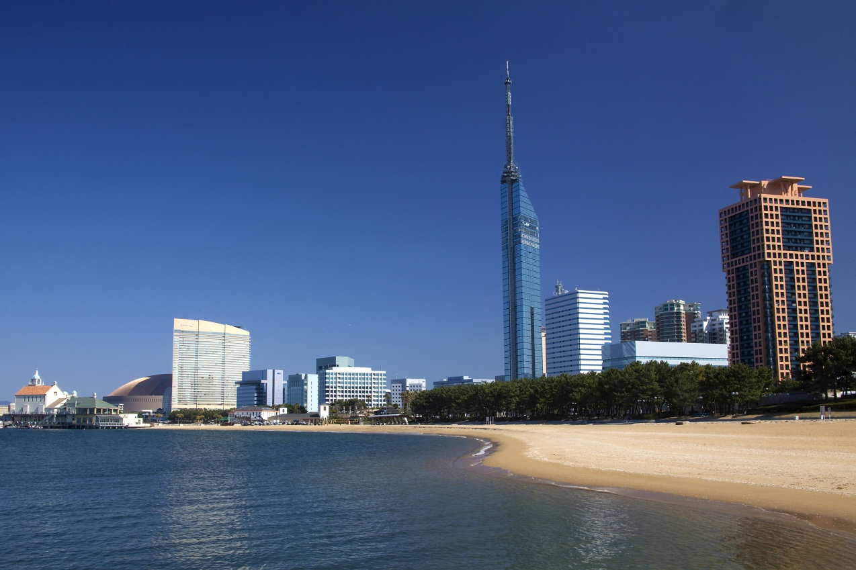
Thank you for your attention.
Photo : “Seaside Momochi (2010)” (Source : Fukuoka City)
http://showcase.city.fukuoka.lg.jp/photo/img0091.html

