Slide 1
Data Governance Committee Review Report
March 31, 2013
This document is a provisional translation by Open Data Promotion Consortium

Slide 2
Table of Contents
    1. Direction of Review
    ・ Present conditions and problems of the conditions for use of public data
    ・ Direction of problems resolution
    2. Basic Idea of overseas secondary use
    3. Comparison of licenses used overseas
    4. Review of license to be usable in Japan(methods of specification of conditions for use)
    5. Case Study(Information and Communication White Paper, statistics related information home pages, maps)
    ・ Confirmation of the existence of problems in case of trial adoption of license and solutions, etc. (conducting hearings from the department in charge).
    6. Review of the draft terms and conditions for use and draft provisions of consignment agreements, etc.
    ・ Draft terms and conditions for use：methods and content, etc. of describing in the website and the data
    ・ Draft provisions of consignment agreements, etc.：Matters necessary to enable concentration and secondary use of copyrights
    7. Any other matters of note
    ・ Ex.：Establishment of helpdesk, enhancement of FAQ and providing training for staffs, etc.
    8. Proposal to the Electronic Administration Open Data Working-level Meeting

Slide 3
1. Direction of Review

Slide 4
(1)Present conditions and problems for the terms and conditions of use of public data
There are now the following examples of the conditions for use of public data* held by the national government, etc.
Looking at the terms and conditions for use of public data, many specify that use shall be permitted within the limitation of copyright and that individual license shall be required for secondary use of the data, which do not encourage active use of the public data.
* Public data refers to the data held by the national government, incorporated administrative agencies, municipalities and public corporations, etc.
In addition to numerical data, including statistical data, they shall include such works as white papers.
Content of Terms and Conditions of Use(Present) | Problems
(Example on the Home Page of the Ministry of Internal Affairs and Communications) ※Similar descriptions are found on the websites of other Ministries and Agencies. - Individual information published on the “Home Page of the Ministry of Internal Affairs and Communications” (letters, photos and illustrations, etc.) are protected by copyrights. The entire “Home Page of the Ministry of Internal Affairs and Communications” are protected by the copyright as the edited work of and protected by the Copyright Act of Japan and international treaties. - All or part of the content of the Home Page may be cited or transcribed and reproduced by specifying the source in a proper method as personal use or the acts permitted by the Copyright Act, including citations. - Provided, however, that for those noted as “All rights reserved, etc.,” please observe them. - All or part of the content of the Home Page may not be altered without permission of the Ministry of Internal Affairs and Communications. | - It only states the matter of course that the acts permitted by the Copyright Act(personal use and citation, etc.) may be done freely.(Secondary use, including alteration, etc. is not licensed in advance.)
(Example of the Home Page of the Ministry of Internal Affairs and Communications, Statistics Bureau) [Copyright] - Such information as explanation texts and illustrations, etc. published on the Home Page are protected by copyrights. The entire Home Page are protected by copyrights as the edited work. All or part of the Home Page protected by the copyright are protected by the Copyright Act and international treaties. - If part of the Home Page is cited or transcribed, it may be done as the act permitted under the Copyright Act by specifying the source. - In case of reproduction for commercial use, please give prior notice to the Ministry of Internal Affairs and Communications (stat_webmaster@soumu.go.jp) - All or part of the Home Page may not be altered without permission of the Ministry of Internal Affairs and Communications. [Citation and Transcription] - If you cite or transcribe part of the Home Page (including Excel files and PDF files, etc. which can be downloaded from the Home Page), please specify the source (Name of Ministry and name of statistics and surveys, etc.) | - Scope of data covered by copyrights is ambiguous. - It only states that for the data protected by copyright, the acts permitted by the Copyright Act (personal use and citation, etc.) may be freely done (Secondary use, including alteration is not licensed in advance.) - Reproduction for commercial use shall require prior notice.
[Source] The column of “Content of Terms and Conditions for Use (Present)” is excerpted from the website of the Ministry of Internal Affairs and Communications and (http://www.soumu.go.jp/menu_kyotsuu/policy/tyosaku.html) the Ministry of Internal Affairs and Communications, Statistics Bureau(http://www.stat.go.jp/info/riyou.htm)

Slide 5
(2) Direction of Problem Solutions
In order to make the public data held by the national government, etc. to be widely used by the people easily, it is an urgent task to consider in the direction of relaxing the restrictions on the terms of use, including the treatment of copyrights held by the national government, etc. and clarifying them. (Note that numerical data and the laws are not protected by the copyright.)
Consideration of the aforementioned, it is necessary to be fully aware that the public data held by the national government are made by tax, which are common assets of the people.
Direction of Problem Solutions | Specific Content and Problems
(1) Making into public domain by legislation | O If the Copyright Act is amended so that copyright shall not accrue to the public data held by the national government, etc. following the legislation of the United States, users cay use the data freely to the largest extent. X On the other hand, long period of consideration is required for amendment of the Copyright Act. * While the copyright act is the system which grants exclusive right of copyright as the incentive to encourage creations, there seems to be no room for the copyright to work as an incentive for the process of creation of public data, which are made by taxes of the people.
(2) Waiver of Copyrights by the National Government, etc. | O Under the framework of the current Copyright Act, users may freely use the data by waiver of copyright by the national government, etc. X On the other hand, as copyrights can constitute the property rights of the national and local governments, it is necessary to consider whether waiver is appropriate or not in relation to the National Property Act, Public Finance Act, Local Autonomy Act and the Act for Normalization of Grants, etc.
(3) Employment of the Rules for Use to facilitate secondary use. | O Following the examples of part of Europe and Australia and New Zealand, it can be realized earlier that the license declaring non-exercise of part of copyrights to facilitate secondary use on presumption that the national government, etc. has copyrights and indicate the scope of use for users to easy to understand and the data can be used online without individual negotiations, which can result in the effect similar to (1) and (2) above and can be realized earlier. * In consideration of which license shall be specifically selected, it is necessary to incorporate the viewpoint of ensuring compatibility with the licenses adopted in foreign countries.(For the details, refer to P.13)
While medium and long-term consideration of the copyrighted public data, including amendment of the current acts, is required for the methods set forth in (1) and (2) above, based on the needs of fastest promotion of open data, the Data Governance Committee will consider (3) the employment of the rules for use to facilitate secondary use, which enables simple treatment of copyrights and can be realized earlier.

Slide 6
Reference 1: Copyrightability (1)
According to legal theories and precedents, no copyright accrues to numerical data.
Definitions of “Work”
“Production in which thoughts or sentiments are expressed in a creative way and which falls within the literary, academic, artistic or musical domain.”(Copyright Act, Article 2, paragraph 1, item 1)
Examples of descriptions in legal theories about the copyrightability of data
- Moriyuki Kato ‘Lectures on the Copyright Act by Clause by Clause, 5th revised edition’
For production not containing thoughts or sentiments, there are for example the data, such as the depth of the Philippine Trench is X m or the average temperature in May in Tokyo is X degree, and since they do not contain thoughts or sentiments, they cannot be copyrighted works.(P.19)
- Nobuhiro Nakayama ‘Copyright Law’
The data of share prices and temperatures, etc., the facts in natural world (for example, “natural law that ‘the earth rotates itself’), historical facts(for example, the fact that ‘in 1600, Battle of Sekigahara was fought’)cannot be copyrighted works even though the person discovered it after great diligence.(P.38)
Descriptions in Precedents
- Kyoto University Doctoral Thesis Case(Decision of Intellectual Property High Court, May 25, 2005)
As the data of experiment results, etc. are facts or ideas and not the works, the graph only expressing the data based on a general method does not have the creativity of work, although there are some range of variation of expressions.

Slide 7
Reference 1: Copyrightability (2)
Provided, however, that the database, which can be recognized as having creativity by “selection or systematic composition of information” after collecting data, will be protected by copyright.
Descriptions in Precedents
-Decision of the Tokyo District Court, March 17, 200012.3.17 ‘Town Page Case’
Occupation category system of Town Page database classifies individual occupations in terms of convenience for search and are composed to cover all occupations by accumulating them by layer, in which contrivance unique to the Plaintiff was made and there seems to be no other similar production, the Town Page database classifying telephone numbers by occupation based on the occupation category system can be determined to be a work of database having creativity by its systematic composition.
-Decision of the Tokyo District Court, February 21, 2002 ‘Corenet Case’
The database of the Plaintiff should be referred to as enormous amount of information classification system as determined above, which were prepared for efficient search by computers of the information required by developers of new construction condominiums and the information classification system in such a scale cannot be referred to as common to selection of information and systematic composition(snip.)・・In selection and systematic composition of information, they can be recognized as having creativity of work of database with copyrightability referred to in the Copyright Act, Article 12-2.
There are laws, notices and precedents, etc., which do not fall under copyrighted works under the Copyright Act.
Works not the subject of rights
-The following four categories are not regarded as falling under copyrighted works. (Copyright Act, Article 13)
  a)The Constitution and any other laws
  b)Notifications, instructions, circulars and those similar thereto issued by the organizations of national or local governments, incorporated administrative agencies or local incorporated administrative agencies.
  c)Judgments, decisions, orders and adjudications of courts and awards and decisions of administrative agencies, which have the procedures similar to trial.
  d)The translations and editions of the above three categories, which are prepared by the organizations of national or local governments, incorporated administrative agencies or local incorporated administrative agencies.

Slide 8
Reference 2: Related Laws (1)
Content of Rights of the Copyright Act
- Moral rights of author(right to protect personal rights of author)
Right of Publication (Article 18) | Right to determine whether to publish unpublished works.
Right of Indication of Author’s Name (Artile19) | Right to determine whether to indicate the author’s name on the work or what name should be used in case of indicating the name.
Integrity Maintaining Right (Article 20) | Right not to have the content or title of the work altered against the will of the author
- Copyright (Property Right)(Right to license or prohibit the use of works)
Reproduction Right (Article21) | Right to reproduce works in tangible forms by printing, photos, copying, recording, video taping and any other methods
Performing Right (Article 22) | Right to publicly perform and play the works.
Projection Right (Article 22-2) | Right to publicly project the works
Public Transmission Right, etc. (Article 23) | Right to publicly transmit copyrighted works or communicate the transmitted works publicly
Recitation Right (Article 24) | Right to publicly communicate the works orally.
Exhibition Right (Article 25) | Right to publicly exhibit the art works or unpublished photo works in their original works.
Distribution Right (Article 26) | Right to furnish to the public the film works by assignment of the reproductions or lease.
Assignment Right (Article26-2) | Right to furnish to the public the works other than film works by assignment of the original or reproductions (Assignment right shall not apply to the assignment after the lawful assignment of works.)
Lease Right (Article 26-3) | Right to furnish to the public the works other than film works by lease of their reproductions.
Translation /Adaptation Right, etc. (Article 27) | Right to translate, arrange, transform, dramatize of film works and the right of adaptation thereof.
Right to use Derivative Works (Article 28) | Right to use derivative works such as translations and adaptations
[Source] Agency of Cultural Affairs Website(http://www.bunka.go.jp/chosakuken/gaiyou/kenrinaiyou.html)

Slide 9
Reference 2: Related Laws (2)
National Property Act, etc.
- Whether copyright is included in national properties, etc.
 | Provisions | Content
National Property | National Property Act Article 2, paragraph 5 | Patent right, copyright, trademark right, utility model right and any other similar rights.
Public properties of local governments | Local Autonomy Act Article 238, paragraph 5 | Patent right, copyright, trademark right, utility model right and any other similar rights.
- Restrictions on Use of the Property
Property | Act | Restrictions | Provisions
National Property | When allowing the person other than the national government to use administrative properties or to gain profits therefrom. | The head of each Ministry and Agency which administers the national property shall have consultations with the Minister of Finance. | National Property Act, Article 14
 | Lease, exchange, sell, assign, trust or use it as the subject of contribution the administrative property or establish private right thereon. | Prohibited | National Property Act, Article 18, paragraph 1
 | To use administrative properties or gain profits therefrom to the extent not disturbing the usage of purpose thereof. | Permitted | National Property Act, Article 18, paragraph 6
Administrative properties out of public properties of local governments | Lease, exchange, sell, assign, trust or use it as the subject of contribution the administrative property or establish private right thereon. | Prohibited | Local Autonomy Act, Article 238, paragrrpah4-1
 | Use administrative properties or gain profits therefrom to the extent not disturbing the usage or purpose thereof. | Permitted | Local Autonomy Act, Article 238, , paragraph 4-7
Properties acquired or utility of which increased by subsidiary projects | Use, transfer, exchange, lend or offer for security in violation of the purpose of granting subsidies., etc. | Prohibited unless the approval of the head of each Ministry and Agency is obtained; except for the cases provided for in the Government Ordinance.. | Act for Normalization of Grants, Article 22
National Property | Exchange or use for other means of payment or transfer or loan without appropriate consideration. | Prohibited except for the cases provided for in the laws. | Public Finance Act, Article 9
[Source]Prepared by the Secretariat based on each of the laws

Slide 10
2. Basic Idea of Overseas Secondary Use

Slide 11
(1) Basic Idea of Overseas Secondary Use
In the Recommendations of OECD and EU Directives, it is specified that secondary use of works and data shall basically be recommended.
NZGOAL and AusGOAL recommend indication license of Creative Commons License (hereinafter referred to as “CC-BY”)as the standard license and it is also used in Germany, etc..
  Indication license of creative commons license is the license which permits free use, including commercial use on condition of indication of sources.
 | OECD Recommendation of Use of Public Information | EU PSI re-use Directive (Draft Amendment of 2011) | New Zealand (NZGOAL, etc.) | Australia (AusGOAL, etc.)
Secondary Use of Data | Unnecessary restrictions on how information is used, reused, integrated or shared shall be eliminated and all usable information shall generally be open and can be reused by everyone. | Make the subject documents securely reused whether commercial or non-commercial purposes. | Service State agency(the organization in charge of Open Data)strongly recommends the principle to “license reuse of works(NZGOAL) Recommends Creative Commons, particularly CC-BY as default of license(NZGAOL) | Recommends Creative Commons, particularly CC-BY as default of license (Open Government Declaration, AusGOAL)
[Source] Prepared by the Secretariat from home pages of each project and draft treaties

Slide 12
Reference 1. OECD Recommendation of the Council for
Enhanced Access and More Effective Use of Public Sector Information
”OECD Recommendation of the Council for Enhanced Access and More Effective Use of Public Sector Information” of 2008 recommended member states to carry out the following 13 principles upon due consideration in reviewing and establishing the policy for access and use of public data.
a) | Openness | In order to facilitate use and reuse of public data, maximize the usability presuming the openness principle. If it is refused or restricted, the reasons therefor shall be clarified.
b) | Clear terms and conditions for access and reuse | Eliminating unnecessary restrictions which prevent use, reuse, integration or sharing of information, all usable information shall generally be open and make it available for everyone to reuse.
c) | Data Catalogue | Make thoroughly known what public data can be obtained and reused.
d) | Quality | Systematic data collection and editing shall be carried out for enhancing quality and reliability.
e) | Integrity | Utilize best practices in information management. Maximize the integrity and usability of information. Develop preventive measures for protecting the information from unauthorized alteration of information, etc.
f) | New Technologies and Long-term Storage | Develop compatible technologies for storage, investigation, search technologies which are necessary for the method of accessing and obtaining the public data.
g) | Copyright | Use copyrights in the method facilitating reuse. If the copyright holder agrees, develop simplified mechanism enabling to facilitate wide area access and use.
h) | Pricing | Pricing shall be transparent and shall not exceed the expense limit necessary for maintaining and distribution of information as practicable as possible. Additional charge shall be permitted in such special circumstances as digitalization.
i) | Competition | If public agencies and corporations provide value added services, there won’t be unfair competition in price strategies.
j) | Remedial Mechanism | Provide appropriate and transparent procedures for bringing complaints and appeal.
k) | Public-Private Partnership | Public-private partnership shall be promoted for enabling the public data to be used as appropriate.
ｌ) | International Access and Use | In order to facilitate use beyond borders, compatibility shall be pursued in the system and management of access. Achievement of preparation of common format to be widely used shall be aimed at, pursuing mutual operation and compatibility.
m) | Best Practices | Information about best practices shall be widely shared for improvement.
[Source] Prepared by Secretariat from OECD Recommendation

Slide 13
Reference 2. Directive on the re-use of public sector information (EU)
EU shows in PSI Directive published in 2003 that secondary use of public data shall be facilitated.
Draft amendment of PSI Directive was published in December 2011 and the following changes were proposed.
 | 2003 Version | Draft Amendment of 2011
Purpose of Directive | Allow private sector to reuse the public data. | By amendment of PSI Directive of 2003, aiming at making easier to use wider scope of information.
Scope of Directive | Public Data (Excluding the following information：information about national security, defense, public safety statistical and commercial confidentiality obligation, information about payment of public broadcast, information held by cultural facilities, information about events of cultural facilities and third party works, etc.) | Cultural facilities (libraries, museums and archives, etc.) shall be added to the subject public organizations.
Scope of Use | Reuse of public data shall not be obliged. Appropriateness of reuse shall be determined by each member country. | Regardless of the purpose of use(commercial or non-commercial), all public data shall be made available to reuse.(Article 3)
Format | In order to facilitate secondary use, public agencies shall prepare documents in a manner not dependent on the particular software as practicable as possible and to a reasonable extent. | Data shall be published as practicable as possible in the mechanically readable format accompanying metadata.(Article 5)
Price | Provision to the extent not exceeding the marginal cost shall be encouraged. | Information provision at the marginal cost shall be the upper limit(Article 6-1) If it complies with the evaluation standards which are objective, transparent and provable, it is allowed to charge the price exceeding the marginal cost(Article 6-2)
[Source] Prepared by Secretariat from PSI Directive the draft amendment of PSI Directive

Slide 14
Reference 3. NZGOAL
In New Zealand, on July 5, 2010, NZGOAL was approved by the cabinet meeting as the guidelines for providing public data.
On August 6, 2010, NZGOAL was published on the website of State Services Commission (SSC).
http://ict.govt.nz/guidance-and-resources/information-and-data/nzgoal/
  Document of Approval of NZGOAL (the New Zealand Governments Open Access and Licensing Framework) by the Cabinet Meeting(CAB Min (10) 24/5A)
    Copyrighted works and non-copyrighted data held by SSC shall be accessible and the license to reuse them shall be arranged.
    A step after publication of NZGOAL, the followings shall be considered.
      Twelve (12) months after release of NZGOA, SSC shall report to the Minister of State Service on the status of adoption of NAGOAL by governmental organizations.
  NZGOAL
    The government holds the geographical and spatial information and the information about consigned research reports, etc., which include copyrighted information and the information defined non-copyrighted by the laws.
    Public data held by the government are recognized as containing important and creative financial values, whether copyrighted or not.
    In order to realize the possibility, the government published NZGOAL and will carry out disclosure of information in the databank of SSC.
    There are the following two methods for the rules of use.
      For the copyrighted information, Creative Commons License shall be used.
      For the non-copyrighted information, it shall be indicated as “No Known Rights.”
[Source] Prepared by Secretariat from the website of NZGOAL

Slide 15
Reference ４．AusGOAL
In Australia, in July 2010, “Declaration of Open Government” was published.
In 2011, Australian Information Commissioners published “Open Access Principles.”
Based on the above, AusGOAL (the Australian Governments Open Access and Licensing Framework) was established, which determined the procedures for encouraging disclosure of information.
Declaration of Open Government
    Declared that CC-BY 3.0 would be used as license.
  Australian Information Commissioners Open Access Principles
    Posted eight (8) principles as the core visions of governmental information management.
    a)Open access to information b)Participation of communities c)Effective information governance d)Proper management of information assets e)Make access to information easier f)Clarify the right of reuse g)Access is made possible at a reasonable cost h)Ensuring transparency in decision making and complaint handling
  AusGOAL (the Australian Governments Open Access and Licensing Framework)
    Provide support to public organizations to make easier disclosure of information held by the organizations.
    Provide support so that there won’t be any problems due to personal information, confidential information and third party copyrights, etc. contained in the information held
    Improve efficiency by standardizing the license
    In transfer of information and data between public organizations, aims at reducing intervention of professionals, etc.
[Source] Prepared by Secretariat from AusGOAL website

Slide 16
3. Comparison of Licenses adopted overseas

Slide 17
(1) Overview of Licenses adopted in Foreign Countries
License Name | Overview of License
Open Government Licence | ・ Licence used for open access of British governmental organizations ・ While alteration(reuse) is possible at default, permission／no-permission may be selected for commercial use. ・ The terms and conditions for use are equal to CC-BY and CC-BY-NC of Creative Commons License. ・ Descriptions are made based on EC Directive and British laws, which is the license corresponding to the data base right(sui generis rights*).
Open License (LICENCE OUVERTE) | ・ License used for open access to French governmental organizations. ・ There is only one license type and the terms and conditions for use are equal to CC-BY. ・ Descriptions are made based on the French laws, which is the license corresponding to the database right.
Open Data Commons License | ・ License made by Open Knowledge Foundation ・ In licensing alteration(reuse), succeeding license or non-succeeding license may be chosen. Public domain license is also prepared. ・ ODC-BY is the license corresponding to the database right for CC-BY and ODbL for CC-BY-SA.
Creative Commons License | ・ License made by Creative Commons ・ Commercial/non-commercial and appropriateness of alteration (reuse) may be chosen. ・ Adopted in several countries(governments)(Australia, New Zealand, Germany) ・ Not corresponding to the database right.
* Sui generis rights are the database rights unique to EU which were recognized by EU Database Directive of 1996.
[Source] Prepared by Data Governance Committee Secretariat based on the documents on each license

Slide 18
(2) Comparison of Licenses adopted in Foreign Countries
 |  | Open Government Licence | Open License (LICENCE OUVERTE) | Open Data Commons License | Creative Commons License | (Reference) Public Domain
Operation Body |  | British Government | French Government | Open Knowledge Foundation | Creative Commons
Major Examples of Use |  | UK | France | Paris Germany | Germany New Zealand Australia | USA
Major License Type |  | 2 | 1 | 3 | 6 | -
Terms of Use | Reproduction | Licensed | Licensed | Licensed | Licensed | Possible
 | Alteration (Reuse) | Licensed | Licensed | Selective (Licensed／licensed on condition of the same license) | Selective (Licensed／not licensed／licensed on condition of the same license) | Possible
 | Combination with other information
 | Commercial Use | Selective (Licensed／not licensed) | Licensed | Licensed | Selective (Licensed／not licensed) | Possible
 | Indication of Source | Necessary | Necessary | Selective (Necessary／Unnecessary) | Necessary | Unnecessary
 | Link to License | Necessary | No description | No description | Necessary | Unnecessary
 | No Warranty | Described | Described | Described | Described | －
Remarks |  | Two types of OGL and No Commercial Government Licence. Corresponding to Sui generis rights | Compatibility between CC-BY 2.0 and ODC-BY. Corresponding to Sui generis rights | Three types of ODC-BY、ODC-ODbL、PDDL. Corresponding to Sui generis rights | CC-BY is recommended in Australia and New Zealand.
[Source] Prepared by Data Governance Committee Secretariat based on the documents on each license

Slide 19
Reference 1. Terms and Conditions selectable in
Licenses of Foreign Countries
 |  | Terms | License in which the terms are essential | License in which the terms may be selected
Indication of Source |  | In reproduction, distribution and reuse, etc. of the information issued under the license, it is required to indicate the title, author and URL, etc. of original information. | Open Government Licence Open License Creative Commons | Open Data Commons License
Commercial Use |  | Commercial use of the information issued under the license is licensed. It will be possible to reproduce and sell the subject information as it is and sell the derivative works reusing (altering) the subject information. | Open License Open Data Commons License | Open Government Licence Creative Commons
Reuse | Succeeding | While reuse (alteration) is licensed for the information issued under the license, it requires to adopt the same license as that of the original information for the derivative works made by reusing (altering) the information (causing reuse to be licensed) | Open Data Commons License | Creative Commons
 | Non-succedding | Reuse (alteration) of the information issued under the license is licensed. The terms of use of derivative works made by reuse of the information may be freely determined. Filming and translation of novels, etc. shall be the subject acts. | Open Government Licence Open License Open Data Commons License | Creative Commons
([Source] Prepared by Data Governance Committee Secretariat based on the Creative Commons Website)

Slide 20
4. Review of Licenses which might be adopted in Japan
(Method of Indication of Terms and Conditions for Use)

Slide 21
(1) Review of Licenses which might be adopted in Japan
Comparison of the licenses used in foreign countries in terms of license (terms and conditions for use) to facilitate secondary use on presumption of adoption in Japan shall be as follows.
Terms required of License | Open Government Licence | Open License (LICENCE OUVERTE) | Open Data Commons License | Creative Commons License
License compatible with those of foreign countries | O | O | O | O
Indication of source is required | O | O | O | O
Terms and conditions may be chosen at the time of provision(Appropriateness of alteration／Appropriateness of commercial use) | (Only for commercial use) | X | X (Only for existence of succession at alteration) | O
License has few restrictions | O | O | O | O
Corresponding to no warranty | O | O | O | O
It has the results of adoption by multiple countries(governments) | X | X | O | O
As the license to be adopted in Japan, Creative Commons License seems to be desirable for trial adoption since it satisfies all the terms above
Among Creative Commons Licenses,it seems to be desirable to carry out trial mainly by CC-BY, which has the widest scope of use.
Data Governance Committee conducted a case study this year of the Information and Communication White Paper, statistics related information home page, etc. for sorting out of the problems and their solutions in case of licensing CC-BY.*
  * If CC-BY is not licensed, consider possibility of use of other Creative Commons License(CC-BY-NC which does not license commercial use and CC-BY-ND, which does not license use by alteration, etc.)

Slide 22
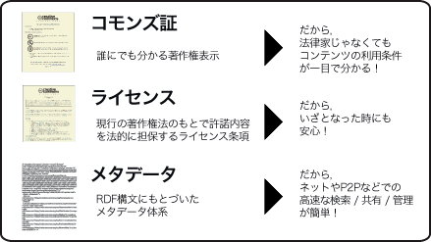
Reference 1. Overview of Creative Commons License
Overview
  Creative Commons collectively refers to international nonprofit organization and its projects, which provides Creative Commons License(CC License)
  The organization was established in 2001 and in 2002, the initial version of license was published in the United States. (In Japan, the initial version was published in 2004.)
  CC License is the tool for various authors of works to express their intention that “everyone can use my works freely if the terms and conditions are complied with,” aiming at new copyright rules for the Internet ages
  Using CC License, authors can freely distribute their works with holding their copyrights and recipients can redistribute or remix within the scope of license.
Features of License
  CC License intends to warrant its effect by the following three factors.
    “Commons Deed”: handy explanations about the content of license, which a person without legal knowledge easily understand the content.
    “License” which legally describes the same content for legal professionals to read(Original Text of License)
    “Metadata” which are the explanatory information incidental to the work (content), used by search engine
[Source] Prepared by Data Governance Committee Secretariat based on the Creative Commons Japan Website( http://creativecommons.jp/licenses/ )

Slide 23
Reference 2. Types and Evaluation of Creative Commons License
Image | License Name | Required Matters |  |  | Evaluation of the Committee for application to Public Data
 |  | Indication of Source | Commercial Use | Alteration
 | Ｉndication 2.1 Japan (CC-BY 2.1 Japan) | Essential (Indicate title, all authors and URL) | Permitted | Alteration is permitted(*) | Recommended as the scope of use is the widest
 | Indication-nonprofit 2.1 Japan (CC-BY-NC 2.1 Japan) | Essential (Indicate title, all authors and URL) | Not permitted (Commercial use of alterations shall not be permitted) | Alteration is permitted(*) | In the electronic administration open data strategies, it is provided “regardless of profit or nonprofit.”
 | Indication-no alteration 2.1 Japan (CC-BY-ND 2.1 Japan) | Essential (Indicate title, all authors and URL) | Permitted | Not permitted | Alteration (secondary use)may not be made.
 | Indication-nonprofit-no alteration 2.1 Japan (CC-BY-NC-ND 2.1 Japan) | Essential (Indicate title, all authors and URL) | Not permitted | Not permitted | In the electronic administration open data strategies, it is provided, “regardless of profit or nonprofit.”
 | Indication-succession 2.1 Japan (CC-BY-SA 2.1 Japan) | Essential (Indicate title, all authors and URL) | Permitted | Alteration is permitted, but the derivative works produced by alteration shall adopt the same license as this license(*) | As only the same licenses can be connected each other, they are difficult to use.
 | Indication-nonprofit-succession 2.1 Japan (CC-NC-SA 2.1 Japan) | Essential (Indicate title, all authors and URL) | Not permitted (Commercial use of alterations shall not be permitted.) | Alteration is permitted, but the derivative works produced by alteration shall adopt the same license as this license(*) | As only the same licenses can be connected each other, they are difficult to use.
* Alteration infringing upon the personal right of the author shall not be permitted.
[Source] Prepared by the Data Governance Committee Secretariat based on the Creative Commons Japan Website( http://creativecommons.jp/licenses/ ), etc.

Slide 24
(2) Matters of Note in adoption of License (Ex.)
- Treatment of the public data in which the data without copyright (numerical data, etc.) are mixed (Ex.：Statistics related information homepage)
  As the licenses, including Creative Commons are prepared on presumption that the subject data are copyrighted, there is an issue of how to treat the public data without copyright.
  If license is granted to the public data without copyright, the following issues arise.
    Although the data is not inherently copyrighted, they are indicated as if they are copyrighted(negative labeling effect).
    On the public data, which are to be used without any restrictions, such restrictions as specification of sources are imposed.
  [Conceivable Response(Ex.)]
    ・After clearly separating the copyrighted part from non-copyrighted part, indication shall be made on each part as not copyrighted or license
    (Provided, however, that take note that it might require much effort to determine the copyrightability.
    ・After granting one license to the entire data and for the non-copyrighted part, exclusion of the license shall specified.
  (Reference) In Australia and New Zealand, after determining the existence of copyrightability, it is specified as “No known rights” on the non-copyrighted data.
- Treatment of the public data in which restrictions by third party rights and contracts, etc. are mixed.
(Ex.: White Papers)
  In case of the public data, in which the works of third parties the copyright and any other rights (portrait right, trademark right, etc.) of which are not held by the national government, there are the following issues related to indication of license.
    For users of the data, it is not easy to tell which are the works of third parties.
    In indication of license, how to treat the part of which the national government may not grant license(method of deleting the pertinent part or specifying that the pertinent part is excluded from application of license can be conceived.)
    In the contract at the time of consignment of research, what terms should be incorporated in the contract in order for the ordering party to obtain the sublicense right of the information prepared in the research.
  For the public data which use the data of third parties of which the national government are restricted from their use by the contract, the same issue exists as an issue related to indication of license.
- Treatment of the public data which are restricted by individual laws
(Ex.：Meteorological Service Act and Survey Act, etc.)

Slide 25
5. Case Studies

Slide 26
(1) Presumption of Case Studies
Each case study was independently conducted by the Data Governance Committee of Open Data Promotion Consortium for each of the subjects.
The Committee independently made reviews of what problems might arise if each of the subjects becomes open data.
As they are not approved by Ministries and Agencies administering each of the subjects, please make inquires about the content with the Committee Secretariat.

Slide 27
5.1 Information and Communication White Paper

Slide 28
(1) Procedures for Case Studies(Overall Picture)
Information and Communication White Paper (Web edition) as the subject, we conducted case studies for the purpose of ａ)sorting out of the problems in case of adopting CC License(CC-BY) and b)research of the labor, etc. required for confirmation of the third party right relations, etc.
The entire Information and Communication White Paper (Web edition) were checked and ａ)extraction and classification of the existence of copyrightability and the portion to be reviewed, in which third parties might have rights and b)upon confirmation of license by third parties and c) it is scheduled to publish by specifying the portion to which CC-BY is not applied.
Information and Communication White Paper
(Web edition)
* Enter the work sheet
*Work Procedure
Extraction of the portion to be reviewed
．．．．．．．．
．．．．．．．．
．．．
．．．
．．．．．．．．
b) Confirmation of license by a third party (each staff)
・For the portion to be reviewed which was extracted and classified in ａ), the following works shall be done.
a. Identification of the person referred to
b. Confirmation of appropriateness of secondary use by third parties
c. (If necessary) request to the copyright holder, etc. for licensing secondary use
d. Arrangement of the confirmation results and request results
・If the workload is heavy (in particular, past materials), it is conceivable to exclude all the portions to be reviewed from CC-BY application.
a) Extraction of the portion to be reviewed
・ Pursuant to the work procedures, extract and classify the pertinent portion.
c) Upon specifying the portion to which CC-BY is not applied, publish.
・ Based on the result of b), specifying the portion to which CC-BY is not applied, publish with the terms of use presuming CC-BY.
※ Enter the results in the work sheet
* Sending the license of secondary use
* ”CC-BY” means “Creative Commons License Indication License.”
This is the license under which free use is allowed, including commercial license
If the source is indicated.
Organization of the confirmation results

Slide 29
(2) Actual Work Procedures (Full Version)
As a result of review of the materials composing Information and Communication White Paper, specific work procedures shall be as follows.
Refer to the next page for explanatory notes

Slide 30
(3) Explanatory Notes to Categories
Explanatory Notes to categories are as follows.
Category | Existence of Rights of third parties (copyright, portrait right, trademark right, etc.) | Category Setting
Data independently prepared by the Ministry of Internal Affairs and Communications | They might include the rights of third parties (For simplified version, confirm with the source Division to apply CC-BY.) | A
Data prepared by the research consigned by the Ministry of Internal Affairs and Communications |  | B
Use upon license to publish by the third party (copyright, portrait right and trademark right, etc.) | As there certainly exist the rights of third parties, it is necessary to confirm. (For simplified version, indicate, “CC-BY not applicable” without confirmation) | C
Publish and use in accordance with the citation rules authorized by the Copyright Act |  | D
Data not subject to copyright, including figures and laws, etc. | Rights in the terms and conditions for use for commercial DB, etc. might operate | E
Category | Indication
CC-BY applicable | O
Confirmation required | ☆
CC-BY not applicable | ★
CC may not be granted, but freely used(no copyright) | -

Slide 31
(4) Actual Work Procedures(Simplified Version)
Some members of the Data Governance Committee expressed their opinions that it is desirable to simplify the above procedures and the procedures reflecting the opinions are as follows.
ａ)For treatment of the portion in which third parties have rights or there might be such possibility, as to the materials which can be confirmed in the Ministry, make efforts to license to use as free as possible by confirming the staff whether to obtain license of the third party, but for the materials of which confirmation is necessary from the outside of the Ministry and the materials which were proved to require confirmation from the outside of the Ministry, “★” shall be attached for arrangement.b)To texts, correspond by the terms and conditions for use as out of extraction. c)For tables and graphs, only those provided by third parties shall be subject to extraction and “★” shall be attached for simplification.
a)The data of which confirmation of right relations shall be made with third parties were organized as out of subject to application of CC-BY.; provided, that those to be confirmed in the Ministry shall be confirmed in the Ministry as practicable as possible
b)All texts were out of extraction. To the cited portions, correspond by the terms and conditions for use.
c)For tables and graphs, only those provided by third parties are subject to extraction and “★” shall be attached for arrangement.

Slide 32
(5) Extraction and Categories of the Candidates for
CC-BY Not Applicable (☆)
Extract those required to confirm of application of CC-BY based on the work procedures.
Those apparently no right accruing under the laws shall not be subject of extraction.
Table: Work Sheet and Work Image(Ex.)
ａ) Published portion | b) Title of table, etc. | c) Indication of Source | d) Published URL | e) CC-BY Check | f) Category | g) Referred to | h) Confirmation result
Table 1-1-6-1 | Path of ICT contribution to growth | Prepared by Akihiko Shinozaki(2006, 2008) etc. | http://www.soumu.go.jp/johotsusintokei/whitepaper/ja/h24/html/nc111300.html | ☆ | C or D
Part 1, Section 1, 3 (In the text) | － | G8 Deauville Summit Declaration of Head of States, “New Committment to Freedom and Democracy” | http://www.soumu.go.jp/johotsusintokei/whitepaper/ja/h24/html/nc111300.html | ☆ | C or D
Table 1-2-5-1 | Examples of ICT Strategies in Foreign Countries | Ministry of Internal Affairs and Communications | http://www.soumu.go.jp/johotsusintokei/whitepaper/ja/h24/html/nc112520.html | ☆ | A
Note：
As it is difficult to determine in form whether used under license or citation, it is indicated here as “C or D.”

Slide 33
(6) Confirmation of Applicability of CC-BY and
Description of the Results (Each Person in Charge)
Along with the work sheet, the person in charge of confirmation (other departments in the Ministry of Internal Affairs and Communications, etc.)shall be designated and describe the results after confirming the possibility of secondary use with the right holders, etc.
Table: Work Sheet and Work Image (Ex.)
ａ) Published portion | b) Title of table, etc. | c) Indication of Source | d) Published URL | e) CC-BY Check | f) Category | g) Referred to | h) Confirmation results
Table 1-1-6-1 | Path o ICT contribution to growth | Prepared by Mr. A (2006, 2008), etc. | http://www.soumu.go.jp/johotsusintokei/whitepaper/ja/h24/html/nc111300.html | ☆ | C or D | Mr. A | O
Part 1, Section1-3 (in the text) | － | G8 Deauville Summit Declaration of Head of States, “New Commitment to Freedom and Democracy” | http://www.soumu.go.jp/johotsusintokei/whitepaper/ja/h24/html/nc111300.html | ☆ | C or D | G8 Deauville Summit Secretariat | ★
Table 1-2-5-1 | Examples of ICT Strategies in Foreign Countries | Ministry of Internal Affairs and Communications | http://www.soumu.go.jp/johotsusintokei/whitepaper/ja/h24/html/nc112520.html | ☆ | A | Mr. B | O

Slide 34
Reference 1. Information and Communication White
Paper Work Results (2012 Edition)
In the Information and Communication White Paper (2102 Edition), sorting out the materials requiring actual confirmation, 665 confirmation matters were discovered.
  It is expected that the materials to be confirmed in the Ministry of Internal Affairs and Communications were 574 and the materials required to confirm with third parties are 91.
When checked in the simplified version, 125 confirmation matters were discovered.
  All of them are expected to be confirmed in the Ministry.
What is no longer necessary to be confirmed by transfer to the simplified version is as follows.
  Candidates for CC-BY not applicable reduced by 540(665→125)
    Texts: 33(to respond en bloc by the terms and conditions for use for the citation portions)
    Tables: Graphs: 441(organized as no copyrighted works, also there is no possibility of rights of third parties.)
    Charts: 22 (as those in which third parties might have rights are classified as CC-BY non-applicable without confirmation)
    Photos: 4(as those in which third parties might have rights are classified as CC-BY non-applicable without confirmation)
    Tables: Graphs: 40( as those in which third parties might have rights are classified as CC-BY non-applicable without confirmation)
Research was conducted in the years before 2011 and about several hundred confirmation matters are discovered.
For more recent ones, persons to be confirmed can be known, but it is expected that for not recent ones, persons to be confirmed seem to be unknown.

Slide 35
(7) Indication Methods based on the Confirmation
Result of Applicability of CC-BY
As the indication methods of applicability of CC-BY, the following three types can be conceived.
  Pattern ａ)： Specify the portions to which CC-BY is “applicable.”
    As there are very many portions requiring specification, easy viewing is lost.
  Pattern b)： Specify the portions to which CC-BY is “not applicable.”
    As compared with specification of the portions to be used, the portions requiring specification will be fewer.
  Pattern c)： Publish by deleting the portions to which CC-BY is not applicable.(the entire published portions can be
  used by CC-BY)
    Due to deletion, the connection among the contents might be lost, which might lead to difficulty in use.
    As the two versions of the original version and the version deleting the portions to which CC-BY is not applicable are to be prepared, work volume will increase and it is practically difficult.
At this moment, Pattern b) seems to be appropriate, but review is necessary for the indication method of the portions to which CC-BY is not applicable.
* In the present draft, distinction is made by marking the pertinent portion(★ mark).
⇒ As there is a concern that ★ mark is not conspicuous(users tend to skip ), we would like to hear the opinions about what mark is desirable.

Slide 36
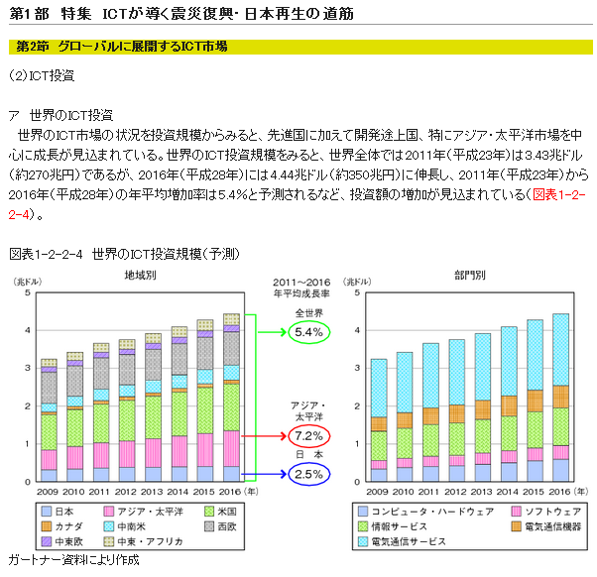
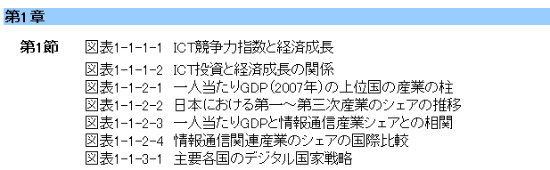
Reference 2. Indication Methods based on the confirmation results of applicability of CC-BY (Ex.)
Describe “★ mark” at the top of the table title to which CC-BY is not applicable.
An example of individual description and an example of describing in the list of tables are shown. As individual description will increase the renewal portions , if it is to be corresponded by the list tables, work volume can be reduced.
Individual Description
Description in the List of Tables
★Chart 1-2-2-4 Global ICT Investment Scale(Forecast)
★Chart 1-1-1-2 Relations between ICT Investments and Economic Growth
★ Chart 1-1-2-3 Corelation between GDP per capita and Information and Communication Industry Shareと

Slide 37
(8) Determination of “No Copyright”
In the simplified version, statistical data, tables and graphs are to be determined “no copyright” and confirmation shall be made of what kind of table has no right.
  Pattern a)： Explanations and comments are described in the graph.
    Where arrows and comments are described in comparison of graphs.
  Pattern b)：Graphs and charts are combined.
    In the explanation of a graph, tables and charts are attached.
  Pattern c)：the content of the table is text.
    In case of the table which contains not only factual information.
  Pattern d)：restrictions are imposed under the license by the source (different from copyright)
    Where graphs are prepared using the data which are licensed only for the use in white papers by the right holder such as commercial database.
    These are not copyrighted, but the right of the original data preparer might remain.
For determination of rights in charts, if a new chart is prepared based on multiple works, it should be checked whether the right of the original authors extend to the chart.
  Pattern e)： A new chart was prepared from multiple works.
    In confirmation of rights, whether it is necessary to confirm the right going back to the original authors.
Response method should be confirmed in case of the portrait right remaining with respect to determination of the right in photos.
  Pattern f)：the portrait right remains.
    Where using the photo of a person, the copyright holder licensed secondary use, but it is unknown whether the license was obtained from the portrait right holder.

Slide 38
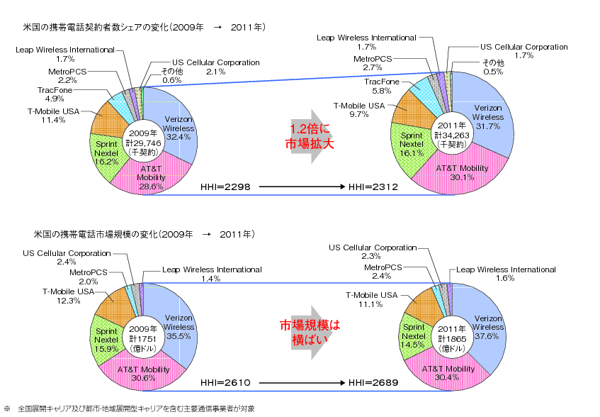
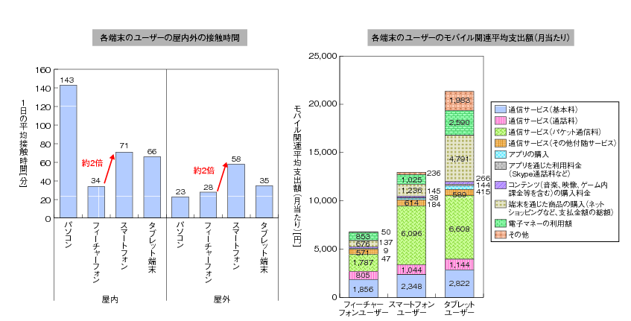
Reference 3. Pattern a)
In comparison of graphs, etc., explaining texts and comments are described.
Chart 2-2-1-14 Trend of mobile communication business in the USA
Chart 2-2-3-7 Comparison by terminal of the contact hours and mobile related expenditure amount
(Source)Ministry of Internal Affairs and Communications, “Research and Study of Trend of Information and Communication Industry and Services and International Comparison 」(2012)
(Source)Ministry of Internal Affairs and Communications, “Research and Study of Trend of Information and Communication Industry and Services and International Comparison 」(2012)

Slide 39
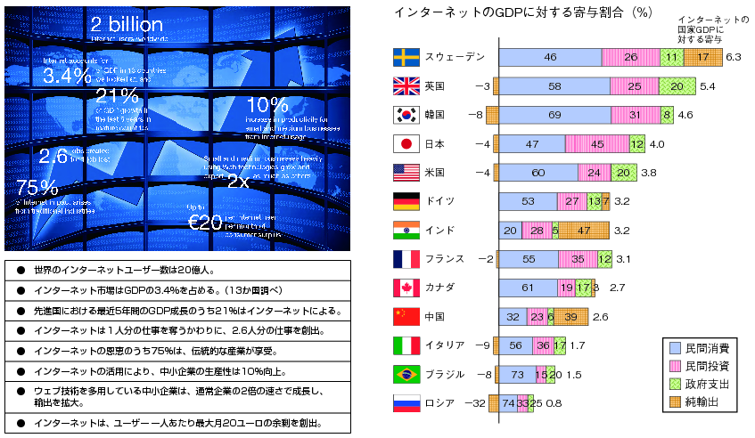
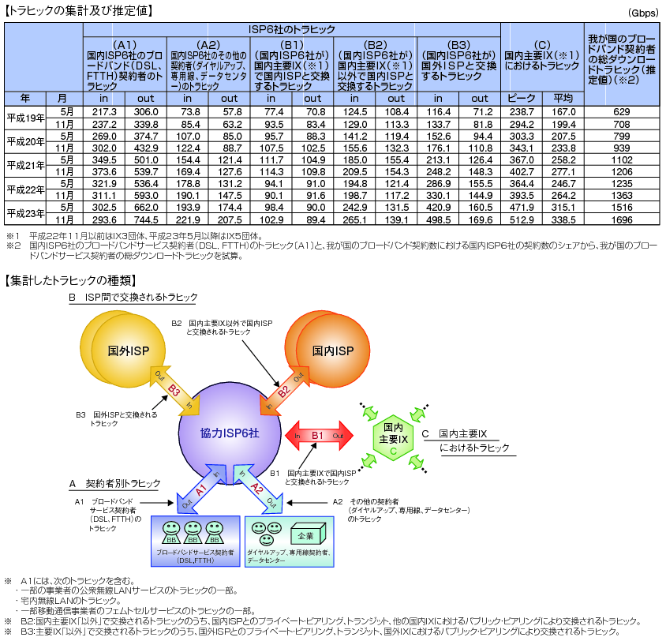
Reference 4. Pattern b)
Graphs and charts are combined.
Chart 1-2-4-1 Contribution of the Internet to Economic Growth
Chart 4-5-3-9 Counting and Trial Calculation of Traffics in the Internet in Japan
(Source)McKinsey & Company, “Internet matters: The Net’s sweeping impact on growth, jobs, and prosperity”
Prepared based on the Ministry of Internal Affairs and Communications, “Counting and Trial Calculation of Traffics in the Internet in Japan “

Slide 40
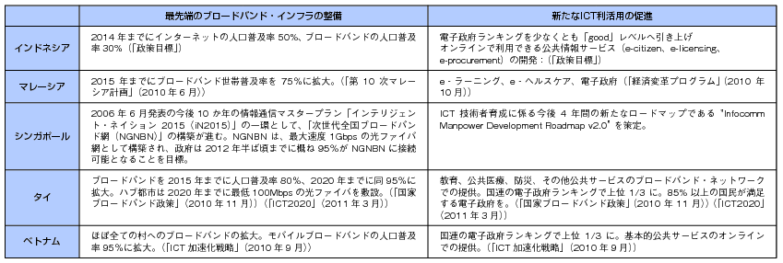
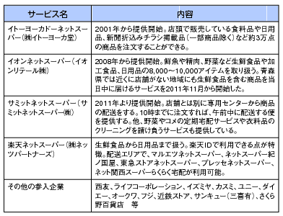
Reference 5. Pattern c)
Summarized in table and the content is in text.
Table 1-2-5-3 Examples of Strategic Approaches in ASEAN Countries
Prepared from various materials
Table 5 Net Supermarket Enterprises and their Approaches
(Source) Ministry of Internal Affairs and Communications, “Research and Study of Advanced Examples of Exploitation and Use of O2O”(2012)
(Prepared from the articles published in various media)

Slide 41
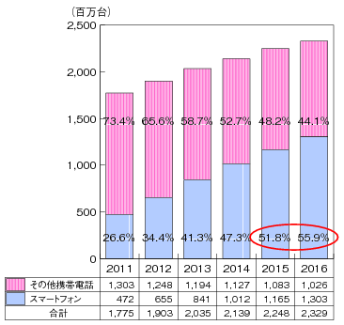
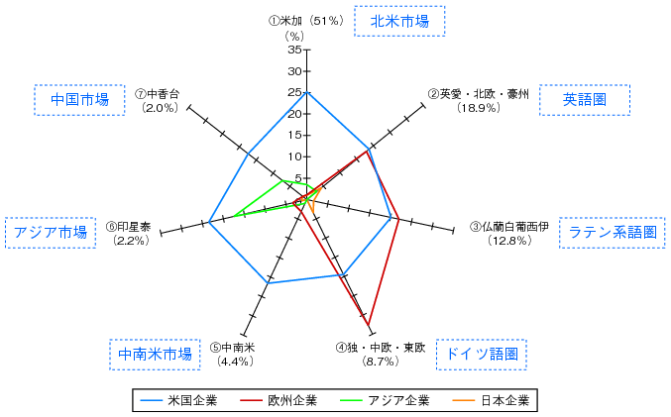
Reference 6. Pattern d)
Graphs prepared by using the data of commercial database, which were licensed by the rightholder on condition that they shall only be used in White Papers
Chart 2-2-1-1 Transitions in Sales Quantity of Smartphones in the Global Sales of Distribution of Mobile Phones (Estimate)
Chart 1-3-3-13 Market Share by Region of Major ICT Vendors in USA, Europe, Asia and Japan
Prepared from Gartner materials
Prepared from Gartner materials

Slide 42
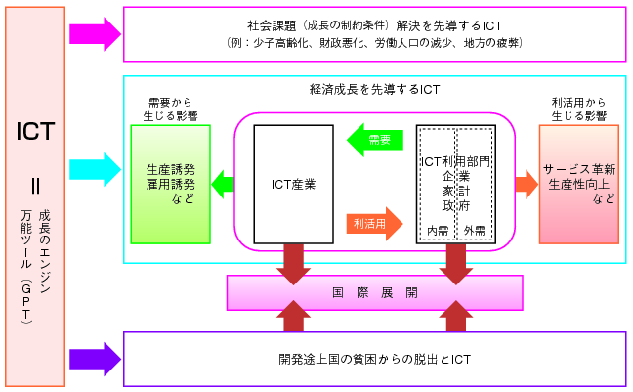
Reference 7. Pattern e)
Where public agencies prepared new charts from multiple works.
Chart 1-1-6-1 Path of ICT contributing to growth
Prepared by Akihiko Shinozaki(2006, 2008), etc.

Slide 43
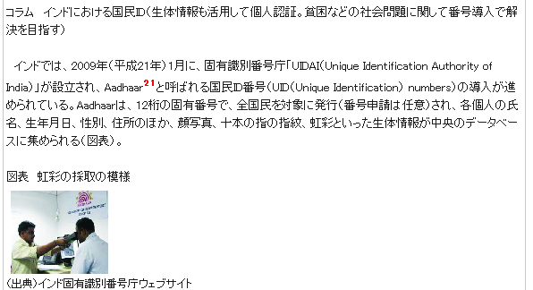
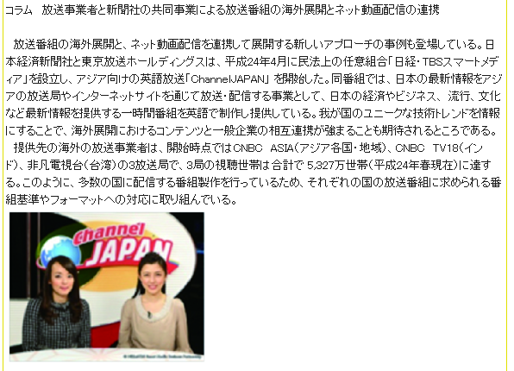
Reference 8. Pattern f)
Where the photos of people are used.
Information and Communication White Paper, 2012 edition
http://www.soumu.go.jp/johotsusintokei/whitepaper/ja/h24/html/nc114920.html
Information and Communication White Paper, 2012 edition
http://www.soumu.go.jp/johotsusintokei/whitepaper/ja/h24/html/nc123210.html

Slide 44
5.2 Home Page of Statistics Bureau and Maps
(Survey Results)

Slide 45
(1) Case Study Results
With reference to the case study method, etc. of Information and Communication White Paper, simple case study was conducted on the home page of Statistics Bureau (Statistics Data Page) and the Maps (Survey Results)
1) Home Page of Statistics Bureau(Statistics Data Page) [ Ministry of Internal Affairs and Communications]
For Home Page of Statistics Bureau, a simple case study was conducted on the statistics data pages in which a large amount of data are published(http://www.stat.go.jp/data/index.htm). Based on the idea of case study on Information and Communication White Paper (Simplified Version), study was conducted on presumption that no copyright is attached to “Tables and Graphs.”
  In the statistics data pages, the portions with copyrights of third parties are fewer than Information and Communication White Paper and it is expected that Category A(independently prepared by Statistics Bureau) and Category E(the data in which non copyright accrues) will compose most of the data.
  However, for the method of case study and the draft terms and conditions for use, those applied to Information and Communication White Paper can also be applied.
2) Maps(Survey Results) [Geospatial Information Authority of Japan]
For maps (survey results), review of the terms and conditions for use is now conducted and the Committee believes that review results should be respected.
Provided, however, that if independent terms and conditions for use are adopted, as much time and labor will be required to carry out mashup with other data(using the data in combination of multiple data), as review of consistency among each of the terms and conditions for use will be necessary, it is desirable to secure compatibility among the mutual terms and conditions for use.
Therefore, in the terms and conditions for use of maps (survey results), it is desirable to consider in the direction of indicating the compatibility with other licenses, including CC-BY, etc.
The Committee will carry out necessary cooperation and review, based on the status of future review by Geospatial Information Authority of Japan.

Slide 46
6. Review of Draft Terms and Conditions for Use and Draft Provisions of Consignment Agreement , etc.

Slide 47
(1) Draft Terms and Conditions for Use ａ)
(Taking an example of Information and Communication White Paper) (Working Draft)
Draft terms and conditions for use for Information and Communication White Paper, the subject of case study, were prepared in order to facilitate secondary use.(These draft terms and conditions for use only cover the pages publishing “Information and Communication White Paper” and not the entire home pages of Ministries.)
It adopted the composition in which after plainly expressing that secondary use may freely be made in general in the beginning, the detailed explanations are provided. For the portions with copyrightability, Creative Commons License shall be adopted to secure the compatibility and machine readability and reference was made to the usability by “Indication of License(CC-BY).”
- Information and Communication White Paper may generally be used freely.
> Information and Communication White Paper (Web Version) may be freely used by anybody, including reproduction, modification, distribution and public transmission, etc., except for the portions to which ★ mark is attached in the Chart List and the texts, etc. of which the sources of third parties are indicated and commercial use is also permitted.
> When using, indicate the sources.(→Examples of indication of sources)
- For the detailed method of use, please refer to the following.
[Portion to which ★ mark is attached and the texts of which the sources of third parties are indicated.]
> In the portions to which ★ mark is attached in the Chart List and the texts, etc. of which the sources of third parties are indicated, third parties might have copyrights and any other rights(Ex.：portrait right and publicity right in photos). When using, please pay attention not to infringe upon the rights of third parties.
> The information in which third parties have copyrights may be used without the license of authors under the Copyright Act such as citation.(→Method of use which does not require license of the author)
[Portions to which ★ mark is not attached]
> As numerical data, simple tables and graphs, etc. are not copyrighted and may be freely used, but we request indication of the sources.
> Copyrights of texts and charts which are copyrightable are held by the national government and managed by the Ministry of Internal Affairs and Communications, which are licensed by “Creative Commons License Indication 2.1 Japan,” which permits free use.
- Indemnification
> Although we make our best efforts to maintain correctness of the published information, if there should be any error, please notify the contact below.
> Ministry of Internal Affairs and Communications shall not be liable for the losses, etc. which were caused to users by the use of the information published in Information and Communication White Pater.
- Contact of Inquiries about Information and Communication White Paper (the following content is provisional)
> Ministry of Internal Affairs and Communications Global ICT Strategy Bureau, ICT Strategy Policy Division, Information and Communication Economy Office

Slide 48
(２)Draft Terms and Conditions for Use b)(Previous Data, etc.)(Working Draft)
While it takes much labor to research the right relations and confirm the licenses of third parties with respect to the previous public data, etc., the use needs many not be great. Considering the cost effectiveness, it is conceivable to publish without confirming the right relations and leave to the judgment and responsibility of users the management of issues related to the rights of third parties. The followings are the draft terms and conditions for use for such cases.
Indication of sources, etc. which is the clue to determination of whether it is the information in which a third party has rights is only a rough indication of right relations. Users shall be liable for infringement of rights of third parties.
* If there are restrictions by individual laws, enter specifically the prohibited forms of use and the applicable individual law in the column of “When using -” As this draft terms and conditions for use follows Information and Communication White Paper, restrictions by individual laws are not described.
- When using
> Information published in Information and Communication White Paper may be freely used by anybody, including reproduction, modification, distribution and public transmission, etc., unless they infringe upon the rights of third parties and commercial use is also permitted.
・> When using, indicate the sources.(→Examples of indication of sources)
- For the detailed method of use, please refer to the following.
(1)Please pay attention not to infringe upon the rights of third parties.
> For the portions in which third parties have copyrights and the information in which third parties have rights other than copyrights( Ex.：portrait right and publicity right in photos), please obtain the individual license at the responsibility of users.
> In this regard, numerical data, simple tables and graphs, etc. are not copyrighted. The information in which third parties have copyrights may be used without the license of authors under the Copyright Act such as citation(→ Method of use which does not require license of the author)
(2)Creative Commons License
> Among the published works, to those in which the national government has copyrights, license is granted under “Creative Commons License Indication 2.1 Japan,” which permits free use.
> As numerical data, simple tables and graphs, etc. are not copyrighted, they are freely used, but we request indication of the sources.
- Indemnification
> Although we make our best efforts to maintain correctness of the published information, if there should be any error, please notify the contact below.
> If users incurred any losses by the use of the published information, the national government shall not be liable for them.
> The national government shall not be liable for the damages due to infringement of the rights of third parties.
- Inquiries (Omitted)

Slide 49
(3) Draft Terms and Conditions for Use c)
(Data to be prepared in the Future) (Working Draft)
★ mark used in the case study of Information and Communication White Paper is an attempt to indicate the portions not to be freely used for secondary use, but it does not clarify whether copyrights of third parties exist or there are portrait rights other than copyrights for not to be offered for secondary use. It is based on the consideration for the burden of work, etc. of confirmation in the previous data.
For the public data to be prepared in the future, by indicating the reasons for not to be offered for secondary use freely with the source of materials, it can accommodate users who intend to make individual handling of rights as much as possible. The followings are the draft terms and conditions for use in such a case.
For the materials on which the words in [ ] of (2) are indicated, they are organized as there are restrictions on use. Where the source is indicated in the name of the Ministry of Internal Affairs and Communications, they shall be limited to those the rights of which were securely treated. If rights cannot be treated, use the indication of 2)[ ].
* If there are restrictions by individual laws, enter specifically the prohibited forms of use and the applicable individual law in the column of “When using -” As this draft terms and conditions for use follows Information and Communication White Paper, restrictions by individual laws are not described.
- When using
> The information which is published in Information and Communication White Paper may freely be used by anybody, including reproduction, modification, distribution and public transmission, etc., unless it contradicts with the rights of third parties and commercial use is also permitted.
> When using, indicate the sources.(→Examples of indication of sources)
- For the detailed method of use, please refer to the following.
(1) Please pay attention not to infringe upon the rights of third parties.
> For the portions in which third parties other than the national government hold copyrights, inquire with the third party or use the materials within the scope of use which does not require license of copyrights.(-> Method of use which does not require license of the author)
* The portions in which third parties hold copyrights are indicated as follows.
[Indication Example：”Source：XX Research(XX Corporation)」](It is described to that effect if secondary use is licensed by third parties.)
> If you use the information in which rights of third parties other than copyrights exist( Ex.: portrait right and publicity right in photos), please inquire individually with the right holder.
* The portions in which third parties have rights are indicated as follows.
[Indication Example: “Note: the above photo has the portrait right,”, etc.]
(2) Creative Commons License
> Among the published copyrighted works, those in which the national government has copyrights license is granted under “Creative Commons License Indication 2.1 Japan,” which permits free use.)
> As numerical data, simple tables and graphs, etc. are not copyrighted and may be freely used, but we request indication of the sources.
- Indemnification, Inquiries (Omitted)

Slide 50
(4) Draft Provisions to be incorporated in Agreements(Working Draft)
For the public data to be prepared in the future, it is necessary to prepare on presumption that secondary use by third parties will be enabled.
Out of the public data to be prepared in the future, if they are prepared by consignment to enterprises, it is desirable to incorporate the following three points in the provisions of consignment agreements.
  a)The copyright in the newly prepared works shall be assigned to the Ministry of Internal Affairs and Communications
  (Where assignment is not possible)license the newly prepared works, including secondary use by third parties.
  b)Not to exercise moral rights if the Ministry of Internal Affairs and Communications and third parties other than the Ministry of Internal Affairs and Communications use the newly prepared works.
  * If the existing works having restrictions on secondary use, that portion shall have the content under which secondary use shall be as much as possible and obtain the license. Distinction shall be enabled to be made between those the license of which enabling secondary use was obtained and those not obtained.
  Hereinafter the draft provisions prepared based on the present standard contract at the Ministry of Internal Affairs and Communications and Consortium Secretariat Companies are shown as an example.
  (Consignor： Ministry of Internal Affairs and Communications, Consignee：Consignee
Article X Copyright and Moral Right
1 Consignee shall assign to Consignor free of charge all the copyrights in the works newly prepared in performing the business (hereinafter referred to as the “New Works”), including the rights provided for in Article 27 and Article 28 of the Copyright Act.
［1 Consignee shall reserve all the copyrights in the works newly prepared (hereinafter referred to as the “New Works”) in performing the business, including the rights provided for in Article 27 and Article 28 of the Copyright Act and shall grant license free of charge, including the right of Consignor to license secondary use to third parties.］
2 Consignee shall not exercise any moral rights against Consignor and the third parties using the New Works and the works held by Consignee (hereinafter referred to as the “Existing Works”)
3 If the Existing Works are contained in the New Works, the copyrights are reserved to Consignee and the Existing Works shall be licensed free of charge as practicable as possible, including Consignor licensing secondary use to third parties. If the works of third parties are contained, the copyrights shall be reserved to the third parties, but Consignee shall obtain license from the third parties as practicable as possible, including Consignor licensing secondary use to third parties. In delivery of the deliverables, pay attention so that the portions enabling secondary use by third parties and those not enabling shall be distinguished and to the portions which third parties are not permitted secondary use, the reasons therefor shall be attached..
a) Describe that the copyright shall be assigned to Consignor.
a)’Description in cases where the copyright is not assigned to Consignor and only license is granted.
b) Describe that moral rights shall not be exercised where third parties make secondary use.
c)Describe that upon obtaining license from the Existing Works as practicable as possible and the Existing Works having restrictions on secondary use can be distinguished.

Slide 51
(5) Other
1) Obtaining secondary use license at news coverage, etc.
For example, when an interview article is prepared and posted on the website of the Ministry of Internal Affairs and Communications, the license of publication on the website was previously obtained from the interviewee by the Ministry of Internal Affairs and Communications or the Consignee, etc. and in the future, it is necessary to obtain the secondary use license in addition to publication.
2) In Case of Re-re-consignment
If the Consignee re-re-consigns (or outsources) part of the business(Ex.；illustration preparation, etc.) it is necessary that the consignment agreement the same as the aforementioned shall be executed with the re-re-consignee to enable secondary use of deliverables.
(Sentence Example)
> The results of this interview will be published as an article on the site XX(URL:********).The site is operated under the policy of enabling everyone to freely make secondary use according to “Creative Commons License Indication 2.1 Japan.”
If you agree to posting on the site, please sign on the letter of agreement in Exhibit.
* Attach the letter of agreement and “Creative Commons License Indication 2.1 Japan” materials in Exhibit.

Slide 52
Reference 1. Examples of Description of Indication of Sources
Examples of Description of Indication of Sources
-These are the examples of describing the indication of sources.
-For the statistical research results, by indicating the sources, the sources of data will be clarified and will be the reference to readers.
-When using on the website, link to the applicable page will be of help to readers.
a) If the texts, charts and photos published in Information and Communication White Paper are used (except for those marked with ★).
Source：” Information and Communication White Paper , 2012”(Ministry of Internal Affairs and Communications)
http://www.soumu.go.jp/johotsusintokei/whitepaper/ja/h24/html/XXXXXX.html (URL of the pertinent page)
b) If other research results by the Ministry of Internal Affairs and Communications published in Information and Communication White Paper are used.
Source：”Research of Trend of Communication Use 2011”( Ministry of Internal Affairs and Communications)
c) If charts published in Information and Communication White Paper in which the person other than the Ministry of Internal Affairs and Communications has copyrights (those to which ★ marks are attached) are used.
(If Information and Communication White Paper and the original source are concurrently indicated.)
Source：” Information and Communication White Paper , 2012”, Original Source：”XX Report”(XX Corporation)
http://www.soumu.go.jp/johotsusintokei/whitepaper/ja/h24/html/XXXXXX.html(URLof the pertinent page)
(Only Original Source is described)
Source：”XX Report”(XX Corporation)
http://www. XXXXXX.html(URL of the pertinent page)

Slide 53
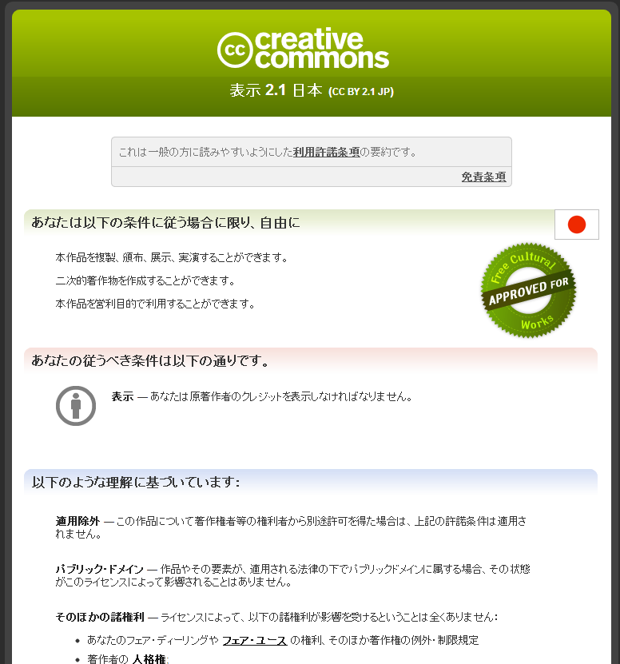
Reference 2. Page of ”Creative Commons License
Indication 2.1 Japan”
http://creativecommons.org/licenses/by/2.1/jp/

Slide 54
Reference ３．Explanation of Citation Rules
Citation Rules under the Copyright Act
・ In Article 32, paragraph 1 of the Copyright Act, it is authorized to cite the assertions and materials, etc. of others if the following conditions are satisfied.
・ For more details, please read, “Copyright Text - For Initial Learners-”
Source：”Copyright Text ～For Initial Learners～」 2012, Agency of Cultural Affairs, Director Secretariat,
Copyright Division
http://www.bunka.go.jp/chosakuken/text/pdf/chosaku_text_100628.pdf
[Conditions] 1 The works are those which were already published. 2 It conforms to the “fair practices.” 3 It is within “legitimate scope” of citation purposes, including reporting, commentaries, researches, etc. 4 “Subordinate-superior relationship” is clarified for the citations and any other parts. 5 “Citations” are clarified by squqre brackets. 6 There is the “necessity” of citation. 7 “Specification of sources” is required(other than copies, where there exist such practice)
Pertinent Provision of the Copyright Act (Citation) Article 32 Published works may be used by citation. In such an event, the citation shall conform to the fair practices and shall be conducted within the legitimate scope of citation purposes, including reporting, commentaries, researches, etc..

Slide 55
7. Other Matters of Note

Slide 56
(1) Other Matters of Note
For the matters of note other than the terms and conditions for use and consignment agreements, the following five matters shall be reviewed in the future adoption of open data.
  Preparation of manuals, etc.
    Prepare the manual describing the procedures, etc. for actually publishing the public data and the manual shall be shared by each Ministry.
    Review the operation flow, including outsourcing so that operations shall be conducted on presumption of publication of the public data.
    Prepare the support tools of publication of the public data, which are prepared in foreign countries so that different treatment shall not be made depending on the judgment of individual staff of each Ministry.(Ex.：AusGOAL, etc.)
  Training for Staffs
    Provide training for staffs for the procedures for publication of the public data.
  Helpdesk for users and Helpdesk for staffs of Ministries.
    Establish the helpdesk for staffs with which the field staffs can inquire about their questions.
    Establish the helpdesk for users with which users can inquire about their questions.
    The content of frequently asked inquiries shall be published in FAQ in paragraph [4].
  Preparation of FAQ for Users・FAQ for Staffs
    FAQ shall be prepared for the frequently asked inquiries, etc. and shall be posted in the portal site for staffs, etc.
    FAQ shall be prepared for inquiries from users.
  Measures for Risks and Accumulation of Knowhow
    If any complaints, etc. arise about the published public data, take actions which will not result in personal responsibilities.
    If multiple similar complaints arise, the mechanism of sharing by each Ministry shall be built up by accumulating the responding knowhow.

Slide 57
8. Proposals to Electronic Administration Open Data Working Level Meetings.

Slide 58
(1) Proposals to Electronic Administration Open Data Working-level Meetings a)
The Data Governance Committee proses the following matters for the rules to facilitate secondary use of public data.
  Public data held by the national government shall be used by anyone freely unless there are actual and reasonable causes for restricting use and it is not appropriate to allow restrictions on use based on the copyright of the national government. Therefore, it shall be thoroughly known to all Ministries that the public data held by the national government shall generally be available for secondary use regardless of the existence of copyrightability.
  For the public data having copyrightability, it is conceivable to deny the copyrights of the national government by legislations, but in terms of promoting quick open data strategies, the national government shall consider development and introduction of the rules to permit secondary use without the national government exercising the copyright.
  In development of the use rules, attention shall be paid to the following matters.
    Use rules shall be unified as practicable as possible for the convenience of use of the data by combining various data by the machine(mashup), and compatibility with the licenses widely used in society shall be specified and also machine readability shall be taken into account.
    If there are the portions in which third parties have rights, including copyrights in the public data held by the national government, as license of third parties might be necessary, the portions shall be clarified as much as possible to bring attention of users(in doing so, it is desirable to add the points of related legal systems, such as numerical data and simple tables and graphs, etc. are not protected by copyrights and there are cases where users may use the data without license of the copyright holders so that the chilling effect shall not arise on users.)
    If there are individual laws, which prescribe that the national government shall regulate secondary use of the public data, the content thereof shall be indicated to be easily understood.
    * As the Data Governance Committee has prepared the draft terms and conditions for use, considering the above points (working draft), please refer to them.(Refer to p 46～p48).

Slide 59
(2) Proposals to Electronic Administration Open Data Working-level Meetings b)
  Treatment of the public data to be prepared in the future and the previous public data shall be distinguished and consider treatment in the following directions.
    For the public data to be prepared in the future, concentration and clarification shall be made in advance on presumption of secondary us, such as the content enabling secondary use of the report shall be incorporated into the consignment agreement where research and study, etc. is outsourced.
    * As the Data Governance Committee has prepared the draft consignment agreement, considering the above points (working draft), please refer to them.(Refer to p 49).
    On the other hand, for the previous public data, if the burden of confirmation of right relations is heavy and it is not practical in terms of cost effectiveness, confirmation of right relations shall be delegated to the responsibility of users and it is sufficient that it shall be specified to that effect in the use rules.
        * As the Data Governance Committee has prepared the procedures for each Ministry confirming the appropriateness of investigation of right relations and licensing by third parties, etc. (refer to p 27 ~ p32) and the draft terms and conditions for use, considering the above points (working draft), please refer to them. (Refer to p47).
  Along the above measures, we would like the relevant parties to carry out various improvement measures for the environment, including preparation of related manuals, providing training for staffs, improvement of helpdesk and FAQ and risk countermeasures, etc.

