Slide 1
December 9, 2013
Open Data symposium
Open Data Promotion Consortium
Activities of Data Governance Committee
in the Fiscal 2013
Open Data Promotion Consortium
Yuriko Inoue
Chair Person, Data Governance Committee

Slide 2
Major Activities in the Fiscal 2012

Slide 3
Major Activities in the Fiscal 2012
1. Examination of Basic Approach to the Issue of Treatment of Public Data
⇒ Reported to the E-Government Open Data Working Level Meeting
2. Implementation of Case Studies on the White Paper of
Information Communications
3. Drafting Rules for the Secondary Usage of the White Paper of
Information Communications
⇒ Realization of Open Data of the White Paper of Information
Communications from April, 2013
4. Drafting Model Contract Document for Government Offices to Outsource
Processing of Public Data
⇒ Continuation of Consideration in the Fiscal 2013

Slide 4
Major Activities in the Fiscal 2012
Examination of Basic Approach
Some public data contains information of which the government holds the copyright.
⇒ Proper settlement of the copyright is required for the
secondary use of the data.
Transaction cost for the settlement of copyright might hamper the secondary use of data.
Public data is generated even without economic incentives of copyright. There is no reason for protection by copyright.
Further consideration on the settlement of copyright of public data is required.

Slide 5
Major Activities in the Fiscal 2012
Examination of Basic Approach
Direction of Issue Solution | Details and Issues
(1) Making them Public Domains by Legislation | O As is the legislative case of the US, changes in the Copyright Act for preventing the generation of copyright in the case of public data owned by the government, etc. will allow the free use of data. X However, it takes a long period for changes in the Copyright Act.
(2) Waiver of Copyright by the Government, etc. | O In the existing copyright framework, users can freely use public data by the waiver of the copyright by the government, etc. X However, since copyright can be a part of property right of the government and local authorities, etc., careful consideration is required if the waiver of copyright is appropriate in the context of national property law, public finance law, local autonomy law, law on rationalization of budgetary spending on subsidies, etc.
(3) Adoption of License for Secondary Use Promotion | O Without denying the copyright owned by the government, etc., the adoption of license that declares disuse of a part of copyright for the promotion of secondary use, and with clear description of the scope of use for the convenience for users, and with the device that gives online permission of data usage without any individual negotiation will bring about the same effects as listed in (1) and (2) above without taking too much time.
We will continue the consideration of the adoption of license for the promotion of the secondary use of data as listed in (3).
Source ： Report of Data Governance Committee in 2012

Slide 6
Major Activities in the Fiscal 2012
Consideration of License to be Adopted
Major Licenses Adopted in Foreign Countries
Creative Commons License (Australia, New Zealand, etc.)
Open Government License (UK) ⇒ Compatible with CC
Open License (France) ⇒ Compatible with CC
Creative Commons License：Standard Public License
Viewpoints for Consideration
Wide Range of Permission for the Secondary Use of Data with the Condition of Source Indication
Compatibility with Licenses of Foreign Countries
……… in Assumption of Mashup
Machine-Readability
Consideration Focusing on CC-BY of Creative Commons License
Source ： Report of Data Governance Committee in 2012

Slide 7
Major Activities in the Fiscal 2012
Case Study：What about the Data which Contain the Rights of the Third Party ?
White Paper of Information Communications
(Webpage Version)
※ Work Procedure
※ Description on Work Sheets
．．．．．．．．
．．．．．．．．
．．．
．．．
．．．．．．．．
Points that Require Consideration
1. Identification of Points that
Require Consideration
2. Confirmation of Consent of
the Third Party
※ Delivery of Confirmation Document of Consent to the Secondary Use of Data
3. Clear Description of Non-Applicability of CC-BY, and Make Data Open
※ Description of Results on
Work Sheets
Confirmation Results
Source ： Report of Data Governance Committee in 2012

Slide 8
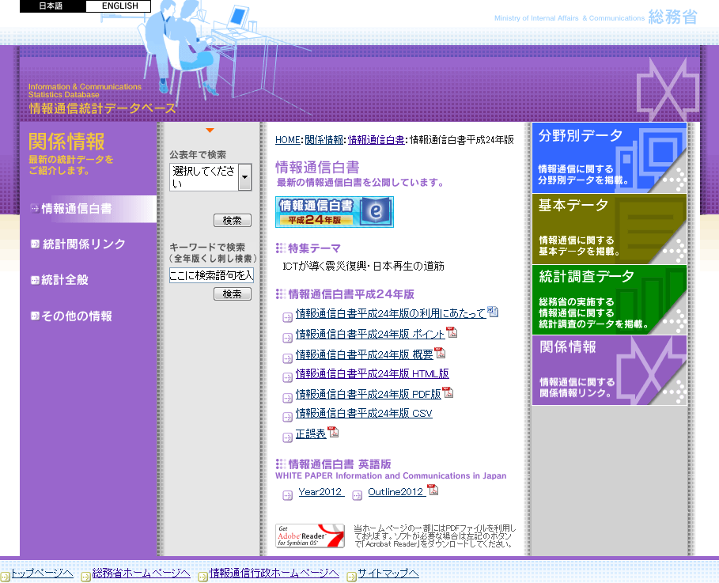
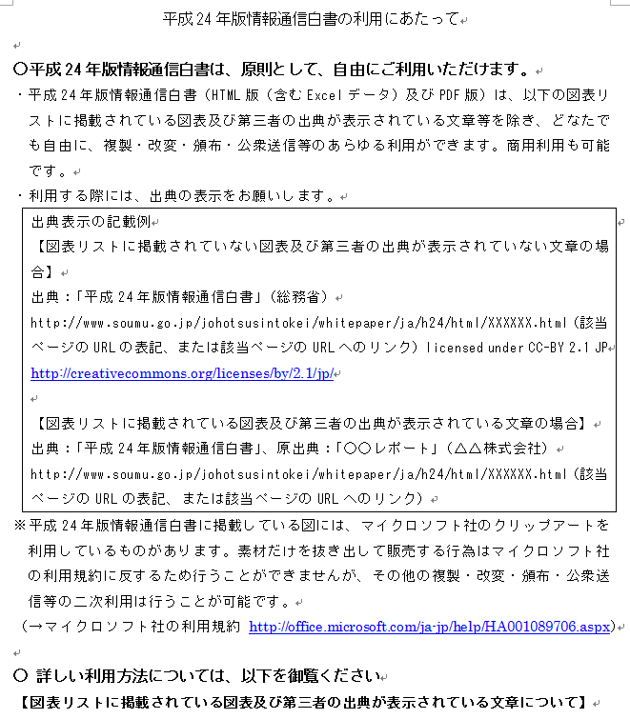
Major Activities in the Fiscal 2012
Making the White Paper of Information Communications into Open Data
Source：Ministry of Communications “White Paper of Information Communications, 2012
http://www.soumu.go.jp/main_sosiki/joho_tsusin/eng/Releases/Telecommunications/130419_01.html

Slide 9
Major Activities in the Fiscal 2013

Slide 10
1. Rules of Use of Webpages of Ministries and Agencies : Situations and Issues
Limited to the Use within the Scope of Rules of Right Restriction in the Copyright Act.
Various Restrictions such as Disapproval of Commercial Use, Disapproval of Changes, etc. ⇒ Free Secondary Use is Impossible.
Example of Rules of Use of Webpage of Ministries and Agencies
About Copyright
Individual information (characters, photos, illustrations, etc.) posted on “the Webpage of XX Ministry” are protected by the Copyright Act. In addition, the whole “Website of XX Ministry” is regarded as compilation and protected by the Copyright Act of Japan as well as international treaties.
A part or the whole of this webpage can be quoted, reprinted and copied with a clear indication of the source in an appropriate manner as private use, quotation or other acts approved by the copyright.
However, in case of items with such notes as “All rights reserved.”, you are requested to follow such instructions.
A part or the whole of this webpage shall not be changed without the permission of XX Ministry.

Slide 11
2. Consideration of Draft Rules of Use of Webpages of Ministries and Agencies
【Government】
“Road Map to E-Government Open Data” (Decision by Comprehensive IT Strategy Office, June 2013)
▪ Based on the consideration by the E-Government Open Data Working Level
Meeting, review and revision of rules of use of webpage of each Ministry and
Agency will be made. (in the latter half of the fiscal 2013)
“Basic Idea of Opening Government Data owned by Government Offices for the Promotion of the Secondary Utilization” (Guideline) (Decision at CIO Meeting, June 25, 2013)
▪ With the principle of the wide range of permission and the minimum restriction
of the secondary use of contents, the clear description of details and grounds of
the restriction, in case of restriction, is required.
The Comprehensive IT Strategy Office of the Cabinet Secretariat requested the Data Governance Committee, in Nov., 2013, to consider drafting the rules of use of webpage of Ministries and Agencies on the premise of the promotion of the secondary use of government data.
In response, based on the draft rules of use of the White Paper of Information Communications prepared in last year, the Committee started consideration.
【Data Governance Committee】

Slide 12
Reference : Road Map to E-Government Open Data
The first half of 2013
The latter half of 2013
2014 FY
2015 FY~
Maintenance of use rule of second use promotion
Review the homepage utilization rule of each ministry and agency (accept the second use in principle and the contents with restriction is indicated individually).
Correspondence to other rules based on arrangement of opinions.
All ministries and agencies
All ministries and agencies
Tackle preferentially about the important field (white paper, disaster prevention information, geospatial information, information about movement of people, budget and account settlement and supply information). The URL list of the data concerned is also released. Maintenance of API is also considered.
Release the information (real time measurement data) other than the text, numerical value (table) and geospatial information in the data format with machine readability.
Expansion of public presentation in a data format with easy machine readability
All ministries and agencies
Expand a release of information in more advanced data format sequentially from a possible part.
All ministries and agencies
All ministries and agencies
Promotion of code openness and utilization promotion of arrangement of code correspondence relation.
Examination and verification of the functions etc. required for the data catalog by demonstration projects.
All ministries and agencies
Maintenance of data catalogue
(portal site)
CAS, MIC, METI
CAS, All ministries and agencies
Maintenance and operation of the data catalog (portal site)
Expansion of the data to be opened in the important field based on discussion of the working level meeting.
Expansion of open data
Related ministries and agencies
Expansion of information disclosure except the one cannot open and is not accepted it’s secondary use for the data among the data with low cost of new homepage disclosure and the data with strong needs (request) of users.
All ministries and agencies
All ministries and agencies
Improve the contents written in the English based on the discussion of the working level meeting.
All ministries and agencies
Construction of sites (collection of links etc.) which introduces useful information
succession
CAS, related ministries and agencies
CAS, related ministries and agencies
Promotion, Education, Evaluation
Support for organizing and participating of promotion event to find and arouse needs and also to create new service, etc.
Construction of structure to reflect the approach understanding needs and opinions.
CAS, All ministries and agencies
Research and evaluation of cost and effect of approach based on a discussion of the working level meeting.
CAS, All ministries and agencies
Research and presentation of open data approach of the local public entity.
Open and promote to the incorporated administrative agencies and local public bodies (including creation and promotion of effective cases)
11
CAS, related ministries and agencies
CAS, related ministries and agencies

Slide 13
2. Consideration of Draft Rules of Use of Webpages of Ministries and Agencies
Points to Note for Consideration of Draft Rules of Use
With reference to the draft rules for use of the White Paper of Information Communications, due consideration to the compatibility with standard public licenses such as Creative Commons, etc.
Ways of description of restrictions on use of specific information items based on individual laws and regulations, if any, contained in the webpages.
Ways of description of restrictions on the secondary use of data, if any. (reasons of restrictions, details of restrictions, etc.)
Aiming at the end of 2013, draft rules of use of webpage will be prepared for the submission to the Comprehensive IT Strategy Office, Cabinet Secretariat.
The draft will be further considered by the E-Government Open Data Working Level Meeting, etc.

Slide 14
3. Preparation of Open Data Manual
Preparation of Manual, for the Staff of Ministries and Agencies, for Procedures of Making Data owned by Government Offices into Open Data and Available for the Public.
Manual Easy to Understand
Manual to Remove Anxiety of Staff, and Reduce Labor of Staff
Manual, Prepared in Collaboration with Technical Committee, to Cover Technical Matters as well
Identification of Risks and Anxieties at the Time of Approval of Use of Data Contents
Consideration of Practical Office Procedures
Preparation of Work Flow at the Time of Approval of Use of Data Contents
Preparation of Draft Manual
Calling for Comments from Ministries and Agencies
Revision Based on Comments
Finalization of Manual

Slide 15
Reference：Draft Table of Contents of Open Data Manual
Preface
Definition of Open Data
Methods of Making Data into Open Data
Practical Methods
Flow Chart at the Time of Open Data Preparation
Flow Chart at the Time of Making Data Open
Selection of Use Conditions
FAQ
Response to Complaints
Proposal of Operation Procedures

