Slide 1
Dec. 9, 2013
Open Data Symposium
Opening Address & Mini Lecture
Open Data and Business
Open Data Promotion Consortium
Chairman, Hiroshi Komiyama

Slide 2
Open Data - Trend and Examples of Utilization
・ Early birds adapted to machine-readability and
international standardization including weather data
services are already up and running.
・ The recent rapid ICT technology development opened up the way to the real-time processing of massive data.
・ This boosted the significant improvement of simulation technology, and higher quality services making use of data analysis capability are emerging.

Slide 3
Sea-Navi Universal Shipbuilding Corp. (Japan Marine United Corp. now)
®
・ It calculates and proposes the most economical sailing route to vessels based on weather and oceanographic forecast data as well as ship navigation monitoring data.
Image of Sailing Route of Minimum Fuel Cost Provided by Sea-Navi
Structure of Sea-Navi
Source：Universal Shipbuilding Corp. (then) (http://www.u-zosen.co.jp/giken/pdf/vol02_b01.pdf)

Slide 4
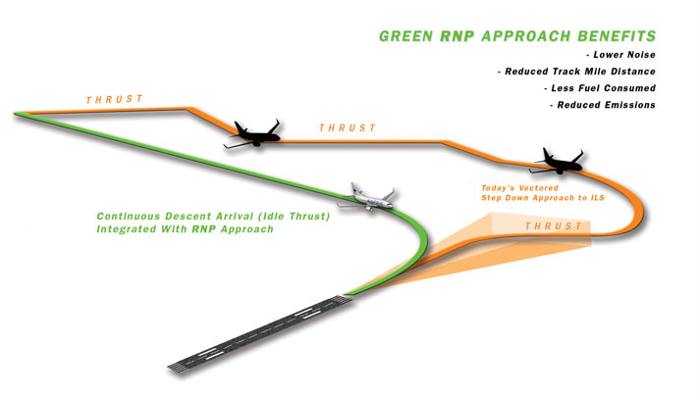
Flight Efficiency Services （GE Aviation）
・ It analyzes and proposes the most fuel efficient flight route based on various meteorological data as well as data from other aircrafts and the destination airport.
Image of Flight Efficiency Services (for Landing)
Source：GE Aviation Web Site (http://www.geaviation.com/systems/products-and-services/air-traffic-optimization-services/performance-based-navigation/benefits-economics.html）

Slide 5
Total Weather Insurance （The Climate Corporation）
・Web-based agricultural insurance firm founded by an ex- Google staff in 2006.
・Provides customized insurance services based on data from National Weather Service, Agricultural Department and data of its own simulation.
・Monsant Co. purchased the company for US $ 1.1 billion, in Oct., 2013.
・Weather data from 2.5 million points (National Weather Service)
・Soil data from 150 billion points
・Harvest data for the past 60 years (both Agricultural Dept.)
・Cloud service (AWS)
・Their own technology for big data analysis and simulation
Webpage of Total Weather Insurance
Forecast of harvest loss by farm and by crop, and income compensation
Photo Source ：http://climate.com/products/total-weather-insurance
Reference ：Webpage of OKFJ （http://okfn.jp/2012/10/22/twi/）

Slide 6
Increased Importance of
Data Utilization in Health Care Sector
・The availability of clinical trial data is a critical factor for development of medical technology and new medicine.
・The record, analysis and utilization of data of daily life such as diet, exercise, sleep, weight, body fat, blood pressure and stress, etc. are the requirements for prevention of lifestyle-related diseases.
・The importance of self medication based on the above data. From cure to prevention and self health care.

Slide 7
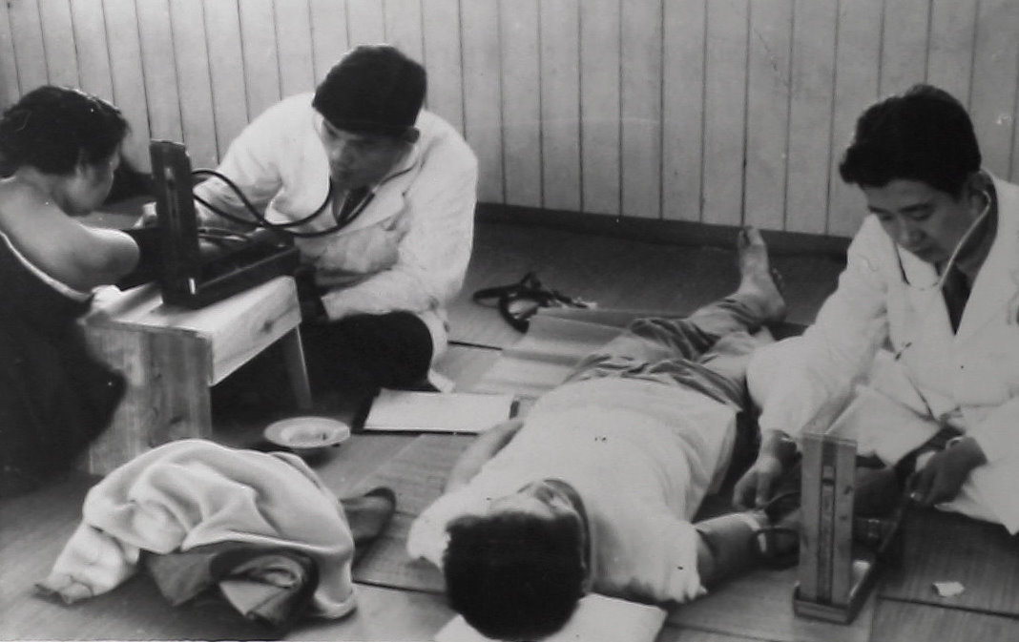
Study in Hisayama Town
(Environmental Medicine, Graduate School of Medicine, Kyusyu University)
・The epidemiological study with high accuracy on lifestyle-related diseases has been carried out for more than 50 years in Hisayama Town in Fukuoka Prefecture. The tracing rate is 99 %.
・Autopsies were performed on nearly 80 % of the deceased people for identifying their precise causes of death and hidden diseases.
・Genome analyses have also been applied since 2002.
・ Various research institutions, local authorities, businesses started studies of Hisayama Town cohort for the development and provision of new services.
(Examples)
・ Prevention of lifestyle-related diseases and dementia, and development of their remedy and drug.
・ Creation of a health care information portal site (Fukuoka Prefecture).
・ Health care consultation site named “Kenkou Mirai Yohou” by Nomura Research Institute.
Scene of Medical Check in 1961
Photo Source ：Webpage of Hisayama Town （http://www.town.hisayama.fukuoka.jp/50kenkou/start.html）
Reference ：Webpage of Environmental Medicine, Graduate School of Medicine, Kyusyu University （http://www.med.kyushu-u.ac.jp/envmed/about/index.html）

Slide 8
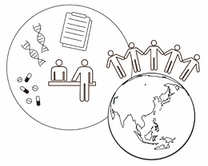
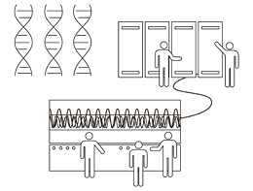
Latest Achievement of
Tohoku Medical Megabank Organization
・The genome analysis of 1,000 healthy Japanese people participated in a cohort study project has been completed. A newly created database easy to retrieve information for researchers of medicine and life science will be made public shortly.
・It will provide reference standard genomes for analyzing gene mutation of Japanese patients and will function as the essential basis for probing into causes of diseases peculiar to the Japanese.
Source of Materials and Photos ：Webpage of Tohoku Medical Megabank Organization （http://www.megabank.tohoku.ac.jp/）

Slide 9
ICT Innovation in the Health Care Sector
Diffusion of ICT Utilization in Daily Life
・Preference of Smart Phones, Tablet
Terminals, Mobile Equipment to PC
・Always Portable / Intuitive Operation
・Easy to Understand with
Animation & Pictures
・Infrastructure Development
for Cloud Computing, etc.
・SNS
・Large Screen UIF
・Wireless
・Others
Healthy City
Development
Healthy
Housing
Innovative Advancement of ICT Itself
・Synergy with Craftsmanship
・M2M, O2O
・Changeover to
Ambient Society
・Big Data Analysis
Food Services
Vehicles / Transport
Prescription
Body Care
Tourism
Dietary Education, PE, Intellectual
Training, Forest Bathing, Sea Bathing,
Hot Spring Cure, Recreation, Food
Therapy, Medication, Targeted Therapy,
Genomic Drug Discovery, Cell Therapy,
etc.
Sports
Relaxation
Industry Promotion
Facilities / Tools
Industry Promotion
Entertainment
ICT
Education /
Training
LETS
Body
Big Data
Symptom
R & D
Information on Life History,
Clinical History, Environment,
External Form, Physiological,
Internal, Genetic, and Neural
Factors.
Lumbago, Migraine, Heart
Disease, Depression, Atopy,
Allergy, Dependence, Amnesia,
Insomnia, Poor Health,
Psychiatric Unstableness, etc.
Advanced ICT Utilization in Medical Technology Sector
・Sensing
・Electronic
Diagnosis
・Genome Analysis
・Remote
Conference
Treatment
Industry Promotion
Insurance & Finance
Assist Robots
Cause of
Disease
Disease
Regenerative
Medicine
PHR Services
Medicine
Preventive
Medicine
【So far】

Slide 10
“Technology” is the Key for Utilization of Open Data
● Technology to cross-sectionally link data in plural fields
⇒ Structurization of wisdom, data standardization,
anonymity setting, etc.
● Technology to collet data mechanically and automatically
⇒ Smart phones, text mining, image analysis, etc.
● High speed and high capacity data processing technology
⇒ Cloud computing, distributed parallel processing,
non-structured data processing, etc.
● High degree and high precision data analysis technology
⇒ Simulation technology, data scientists, etc.

